Slide 1
Amazon web Services (Aws)
AWS Bootcamp

Slide 2

Welcome to AWS Training!
We will start at 8:30 AM.
Find a seat and get comfortable.
Use network ports on the table.
Breakfast and coffee are in the room.
Questions – Ask an AWS representative.

Slide 3
Welcome to AWS Training!
We will start at 8:30 AM.
Find a seat and get comfortable.
Use network ports on the table.
Breakfast and coffee are in the room.
Questions – Ask an AWS representative.

Slide 4
Let’s Get Started…
Today’s Plan:
Your Instructor
Introductions
Logistics
Course Goals
Schedule Review
Cloud Computing
AWS Services:
S3, EC2, EBS, VPC
AWS in Action

Slide 5
Your Instructor…
I’m
Background:
Amazon, Hewlett Packard, Cisco Systems
Interests:

Slide 6



Introductions…

Slide 7
Course Goals…
Understand the concept of Cloud Computing.
Understand Amazon’s major markets for AWS.
Understand the main Amazon Web Services.
Be ready to design your own AWS-powered systems.
Know where to go to learn more.

Slide 8
Logistics…
Day 1: 10:30 AM – 4:00 PM
Day 2: 10:30 AM – 4:00 PM
60 and 120 minute course modules.
Break and Q&A time at end of each module.
Please ask questions if anything is unclear.
Your feedback is very helpful.
Follow along on your laptop if you’d like.

Slide 9
Course Schedule
Course Content
Introduction
Cloud Computing and AWS
Amazon EC2
Amazon EBS
Amazon S3
Amazon SQS
Amazon VPC
AWS in Action

Slide 10

Questions so Far?
Special Requests?
Too Fast?
Too Slow?

Slide 11
Verify Preqrequisites
Download Firefox and Elastic Fox
Firefox
http://www.firefox.com
S3 browser
Search ‘Amazon S3 organizer’
Download SSH client (only for Windows users)
Search ‘putty.exe’ (download puttygen.exe and putty.exe)
Download a RDP client (Linux and Mac users)
http://www.rdesktop.org/#download (Linux)
Search ‘RDP Mac’
http://www.microsoft.com/downloads/details.aspx?FamilyID=6573f9f1-8ae1-4da9-ab5c-f8457ecdaf2d&displaylang=en
Download Java EE capable Eclipse
www.eclipse.org (Eclipse IDE for Java EE Developers)
Download support files
http://aws-bootcamp.s3.amazonaws.com/bootcamp.zip

Slide 12




What is Cloud Computing?
58% say cloud computing will cause a radical shift in IT and 47% say they are already using it or actively researching it.
The current US economy woes will only drive more enterprises to consider and adopt cloud offerings. Spending on IT cloud services will hit $112 bn
by 2017
No less influential
than e-business
Cloud Computing :
Cloud computing is the use of massively scaled offsite IT resources assembled virtually, accessed over the internet, used on demand in real-time or near real-time on a pay per use or subscription basis, where the workloads are shared among multiple customers.
Wikipedia says:
“Cloud computing is a style of computing in which dynamically scalable and often virtualized resources are provided as a service over the Internet.”
SOURCE: CIO Research: http://www.gartner.com/it/page.jsp?id=707508
Notes:
Gartner, Inc is the world’s leading IT research and advisory company.
http://www.gartner.com/it/page.jsp?id=707508
IDC is the premier global provider of market intelligence, advisory services, and events for the IT, telecom, and consumer technology markets.
CIO Magazine - provide technology and business leaders with insight and analysis on information technology trends

Slide 13
Cloud Computing Definition
Cloud computing is a model for enabling convenient, on-demand network access to a shared pool of configurable computing resources (e.g., networks, servers, storage, applications, and services) that can be rapidly provisioned and released with minimal management effort or service provider interaction
(NIST-version 15)
Wikipedia says:
“Cloud computing is a style of computing in which dynamically scalable and often virtualized resources are provided as a service over the Internet.”
© 2008 . All rights reserved
13
Notes:
Virtualization - Multiple virtual computers can time-share a single physical computer!
A hypervisor, also called virtual machine monitor (VMM), is a computer software/hardware platform virtualization software that allows multiple operating systems to run on a host computer concurrently.
VMWare , Xen, Microsoft Virtual PC – Common tools
Xen – Open source VM initially developed at Cambridge
Allows for resource sharing, more utilization and ease of management.
http://csrc.nist.gov/groups/SNS/cloud-computing/cloud-def-v15.doc

Slide 14

Data center

Slide 15
More clouds are predicted to form—get ready
58% of surveyed IT decision makers feel cloud computing will cause a radical shift in information technology driving the next wave of innovation.
Is Cloud Computing On Your Organization's Tech Roadmap?
Primary Reasons You're Using or
Plan to Use Cloud
Yes, currently using or implementing | 30%
No, not on our technology roadmap | 29%
Yes, on the radar or actively researching | 17%
Yes, plan to use within one year | 10%
Yes, plan to use within one to three years | 5%
Not sure | 5%
Yes, plan to use within three to five years | 2%
Scalability on demand/flexibility to the business | 50%
Reduced hardware infrastructure costs | 38%
Reduced IT staffing/administration costs | 35%
Access to skills/capabilities we have no interest in developing in-house | 28%
Not using or planning to use cloud computing offerings | 19%
Capacity - data center | 16%
Capacity - storage | 11%
Frequent software updates | 10%
Other | 5%
SOURCE: CIO Research: http://www.cio.com/article/455832/Cloud_Computing_Survey_IT_Leaders_See_Big_Promise_Have_Big_Security_Questions

Slide 16

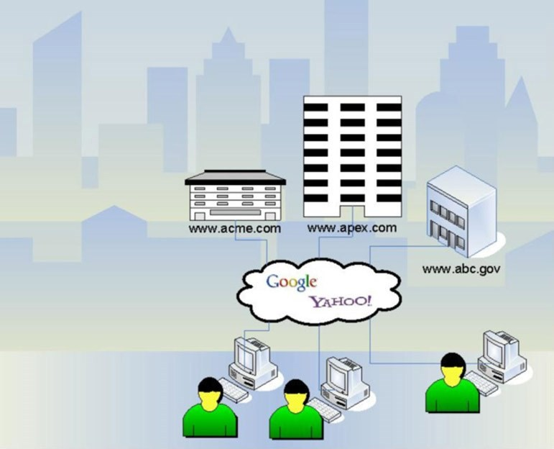
Where are we today?
Evolution of the Web
Web 1.0 (1990s):
▪
Information flow was
strictly one-way
from
web
sites
to
users

Slide 17
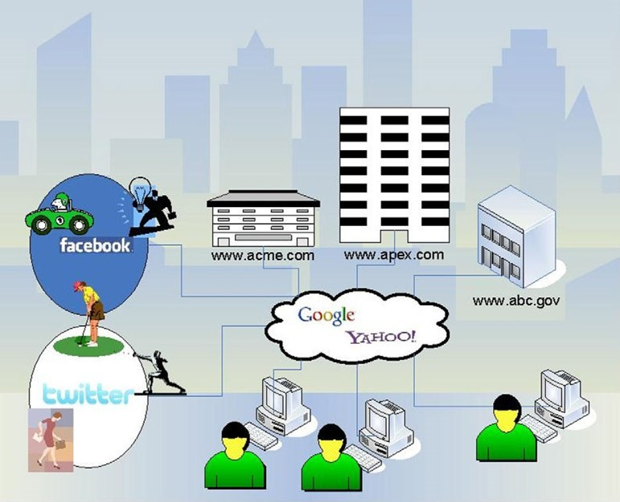
Where are we today?
(contd..)
Web 2.0 (2000s):
▪
Information flow was bi-
directional, thus allowed users to upload
information to
the
Web
▪
Mobile
web

Slide 18
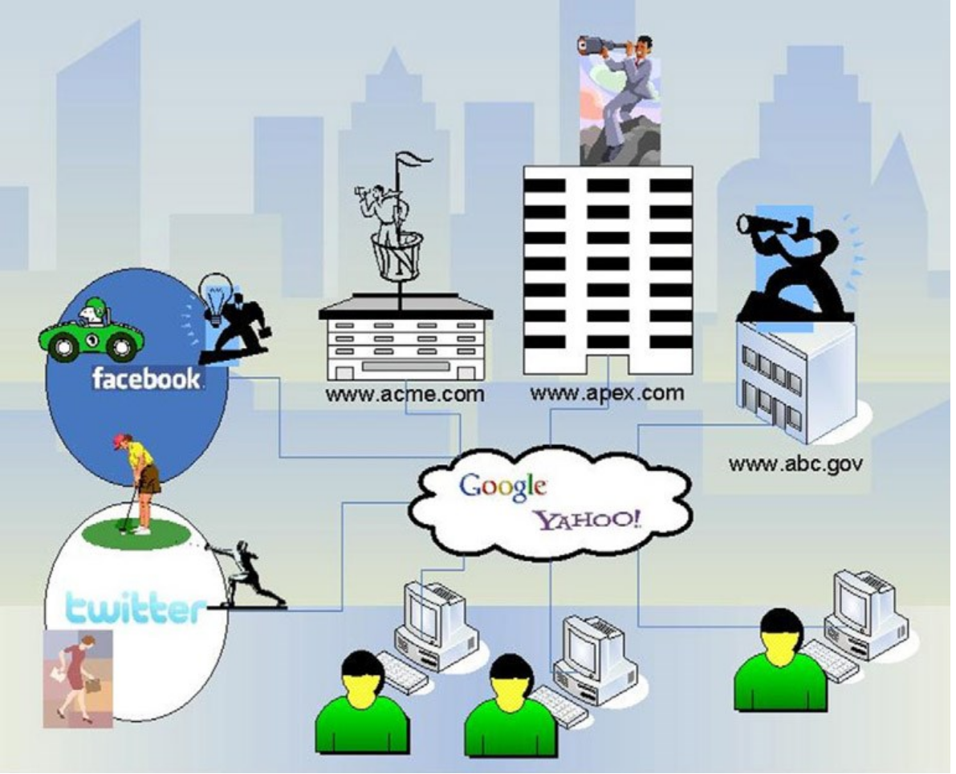
Where are we today?
(contd..)
Web 3.0 (2010):
▪
▪
The next generation Web
Has been humorously called ”Cyberspace looks at You”

Slide 19
Benefits of Cloud Computing What makes Cloud so attractive?
Cost Effective
No Hardware cost.
Cloud technology is paid incrementally (pay what you use/need),
saving organizations investments.
Speed to Value
Virtual
You assemble software stacks of databases, web servers, operating
systems, storage, and networking, then manage them as virtual servers
Storage Elasticity
On Demand Self Service
Organizations can store more data than on their datacenter SAN Storage.
pay as per usage.
Flexibility
Subscription Style Flexibility
The ability to scale up (& down) very easily depending on your needs.
Flexibility in terms of programming models and platforms.
Less Stress
Amazon SLA
Amazon provide you an appropriate SLA, you should not worry about outages
power failures, hackers, Quality of Services, latency, user error, OS patching, cooling.
Redundancy
Simple
The ability to set up redundant instances in their primary data centre
but they also offer Geo-clustering.

Slide 20
Characteristics / Advantages of Cloud Computing
Offsite
Accessing offsite IT resources in a data centre that's not your own.
You don't buy the servers and storage, someone else does
CapEx Avoidance
1
Virtual
You assemble software stacks of databases, web servers, operating
systems, storage, and networking, then manage them as virtual servers
Speed to Value
2
On Demand Self Service
Use when needed, including processors, memory, network,
bandwidth, storage
Rapid Elasticity
3
Subscription Style
These tend to be month-to-month or pay-per-use
Cost Reduction
CapEx Avoidance
4
Shared
To achieve economies of scale, squeeze workloads from multiple
customers onto the same physical machines
Greener IT
5
Simple
Configure resources extremely quickly
Speed to Value
6
Web based
Cloud computing involves browser access to hosted data and resources
Speed to Value
7
Notes:
Cloud computing is the use of massively scaled offsite IT resources assembled virtually, accessed over the internet, used on demand in real-time or near real-time on a pay per use or subscription basis, where the workloads are shared among multiple customers. Let us work through this definition for a moment.
Offsite: you don’t own the IT resources, rather someone else has purchased it and you use it when needed.
Assembled Virtually: virtualization technology allows multiple customer applications to be run on the system or on a machine.
On demand: the resource can be turned on or off quickly and as needed.
Pay per use: use as needed, the economic model is Opex and not Capex, pay for what you need, not for unneeded capacity.
Shared workloads: scale economies exist because of both shared use and also because client traffic may be non-correlated from a time of year usage perspective from other clients.
Massive Scale: access to extremely large infrastructures that one would be challenging to build as a single entity.
The biggest financial benefit of cloud computing, particularly in these capital-constrained times, is avoiding taking on debt and keeping cash in the company longer. If a project uses a cloud-based service provider, then the CFO avoids writing a big check upfront. Instead, checks are written monthly or quarterly, in alignment with the return of investment.
- Forrester Research, Talking To Your CFO About Cloud
20

Slide 21
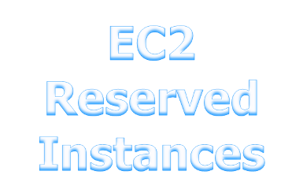
The Forecasting Nightmare
Cost
Large Capital Expenditures
Wasted Money
Bad Things
Happen
Forecasted Load
Traditional Infrastructure
Actual Load
The Getting Started Tax
Cloud Computing
Time

Slide 22
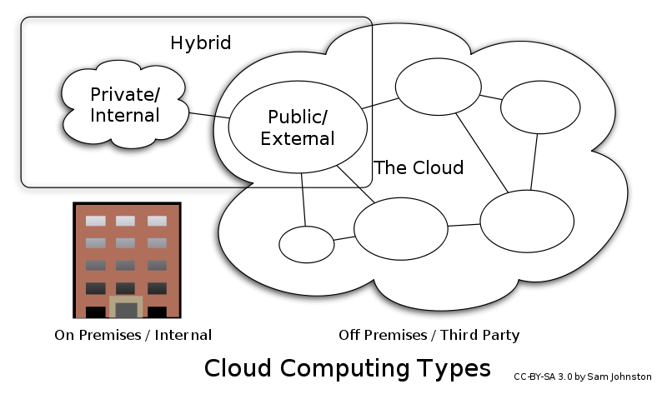
Deployment Models
Private Cloud
On/Off premise infrastructure
Managed by self or third party
Used solely by organization
Public Cloud
Off premise infrastructure
Managed by third party
Used by general public / large
industry group
Hybrid Cloud
Composition of 2 or more clouds
Community Cloud
Shared by specific community with a shared concern
Notes:
Private cloud. The cloud infrastructure is operated solely for an organization. It may be managed by the organization or a third party and may exist on premise or off premise.
Community cloud. The cloud infrastructure is shared by several organizations and supports a specific community that has shared concerns (e.g., mission, security requirements, policy, and compliance considerations). It may be managed by the organizations or a third party and may exist on premise or off premise.
Public cloud. The cloud infrastructure is made available to the general public or a large industry group and is owned by an organization selling cloud services.
Hybrid cloud. The cloud infrastructure is a composition of two or more clouds (private, community, or public) that remain unique entities but are bound together by standardized or proprietary technology that enables data and application portability (e.g., cloud bursting for load-balancing between clouds).

Slide 23
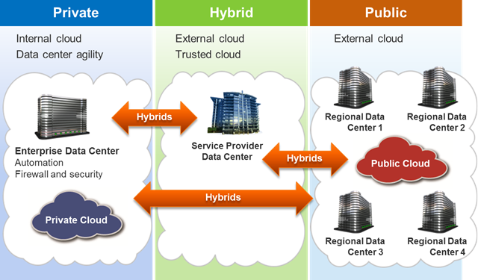
Deployment Models

Slide 24
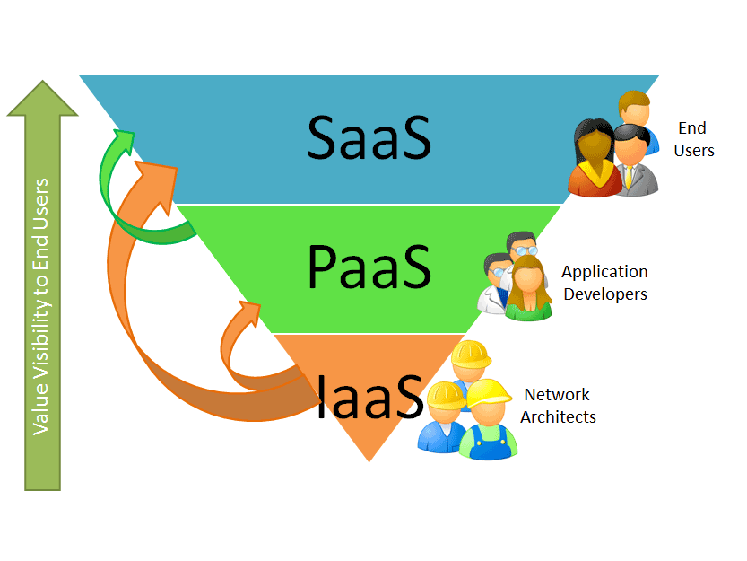
Cloud Stack: Delivery Models
SaaS: Finished applications that you rent and customize
(e.g. Salesforce, Gmail etc)
PaaS: Developer platform that abstracts infrastructure, OS and middleware to drive developer productivity.
(e.g. Simple DB, Google App Engine)
IaaS: Deployment platform that abstracts the infrastructure.
(e.g. AWS EC2, AWS S3)

Slide 25
Different Cloud Service Offerings
Software as a Service (SaaS)
COTS/ERP
Multi-tenant solution
Platform as a Service (PaaS)
Virtual Machine
Custom Development
Shared infrastructure
Infrastructure as a Service (IaaS)
Vendor specific libraries
Virtualised hardware
Dynamic Scaling
"near infinite" headroom
Shared Infrastructure
Shared Infrastructure
Leverages the Cloud in software architecture
Eliminates the need to install and run the application on the customer's own computer
Delivers a computing platform and/or solution stack as a service
Facilitates deployment of applications without the cost and complexity of buying and managing the underlying hardware and software layers
The delivery of computer IasS, typically platform virtualization

Slide 26
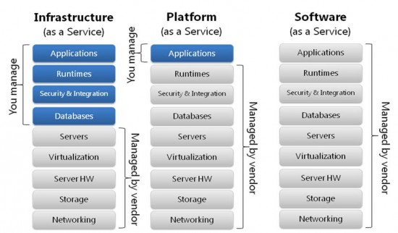

Slide 27


















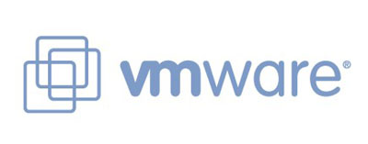

Cloud ecosystem layers
Process-as-a-service
Applications-as-a-service
Platforms-as-a service
Infrastructure-as-service

Slide 28
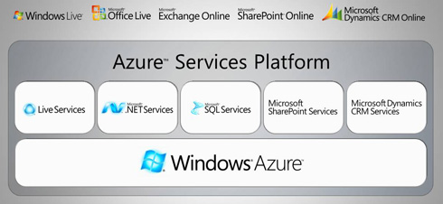






Major Cloud Infrastructure Providers
Microsoft Azure http://www.microsoft.com/azure/default.mspx
Google App Engine
http://code.google.com/appengine/
IBM Blue Cloud
http://www.ibm.com/ibm/cloud/
Go Grid
http://www.gogrid.com/
Joyent
http://www.joyent.com/
Rackspace
http://www.rackspace.com/index.php
Flexiscale
http://flexiscale.com/
© 2008 . All rights reserved
28

Slide 29
Amazon web Services COMPONENTS
AWS COMPONENTS

Slide 30

An overview of AWS
 AWS is Amazon’s umbrella description of all of their
web-based technology services.
 Main services include:
➢
➢
➢
➢
➢
➢
➢
Compute
Storage
Database
Deployment & Management
Application Services
Networking
Content Delivery
.

Slide 31
Services of AWS
Category Service
AWS
_{Compute}  Amazon Elastic Compute Cloud (Amazon EC2)
❖ Auto scaling
❖ Elastic Load Balancing
❖
Amazon Elastic MapReduce (Amazon EMR)
_{Storage} ▪ Amazon Simple Storage Service (Amazon S3)
▪ AWS Storage Gateway
▪ AWS Import/Export
▪
Amazon Glacier
_{Content Delivery} ✓ Amazon CloudFront
_{Networking} o Amazon Virtual Private Cloud (Amazon VPC)
o AWS Direct Connect
o
Amazon Route 53
.

Slide 32
Amazon Web Services Components Step by Step towards AWS
Clients needs:
With AWS:
Compute Power
A interface that can be used to store and retrieve any amount of data
Starting at $.10/Hr
Amazon EC2
1
Storage capacity
A web service that provides resizable compute capacity in the cloud.
Starting at $.15/GB/Month
Amazon S3
2
Block storage
EBS) provides block level storage volumes for use with EC2 instances
$0.10 per allocated GB per month
Amazon EBS
3
Monitoring
A web service that provides monitoring for AWS cloud resources
Amazon CloudFront
4

Slide 33
EC2 : Elastic Compute Cloud
EC2 Instances = Virtual Servers
Resizable compute capacity in 29 instance types
Reduces the time required to obtain and boot new server instances to minutes or seconds
Scale capacity as your computing requirements change
Pay only for capacity that you actually use
Choose Linux or Windows
Deploy across Regions and Availability Zones for reliability
Flexible networking (NAT/classic, VPC, Elastic IPs)
Support for virtual network interfaces that can be attached to EC2 instances in your VPC
Amazon Elastic Compute Cloud (Amazon EC2)
Notes:
Amazon EC2 presents a true virtual computing environment, allowing you to use web service interfaces to launch instances with a variety of operating systems, load them with your custom application environment, manage your network’s access permissions, and run your image using as many or few systems as you desire.
To use Amazon EC2, you simply:
Select a pre-configured, templated Amazon Machine Image (AMI) to get up and running immediately. Or create an AMI containing your applications, libraries, data, and associated configuration settings.
Configure security and network access on your Amazon EC2 instance.
Choose which instance type(s) you want, then start, terminate, and monitor as many instances of your AMI as needed, using the web service APIs or the variety of management tools provided.
Determine whether you want to run in multiple locations, utilize static IP endpoints, or attach persistent block storage to your instances.
Pay only for the resources that you actually consume, like instance-hours or data transfer.

Slide 34
Features of Amazon EC2
➢
➢
Virtual computing environments, known as instances
Pre-configured templates for your instances, known as Amazon Machine Images (AMIs), that package the bits you need for your server (including the operating system and additional software)
Various configurations of CPU, memory, storage, and networking capacity for your instances, known as instance types
Storage volumes for temporary data that's deleted when you stop or
terminate your instance, known as instance store volumes
Persistent storage volumes for your data using Amazon Elastic Block Store
(Amazon EBS), known as Amazon EBS volumes
Multiple physical locations for your resources, such as instances and
Amazon EBS volumes, known as regions and Availability Zones
Static IP addresses for dynamic cloud computing, known as Elastic IP
addresses
➢
➢
➢
➢
➢
.

Slide 35
Predictions : Cost Money
Infrastructure
Cost $
You just lost customers
Large
Expenditure
Capital
Predicted
Demand
Opportunity
Cost
Opportunity
Cost
Traditional
Hardware
Actual
Demand
Automated
Virtualization
time
.

Slide 36
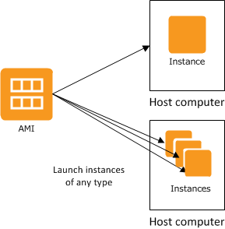
Amazon Machine Image (AMI)
Amazon Machine Image
Building blocks of EC2 instances
An AMI is like a template of a computer's root volume.
Can be public or private
Create hardened or gold “Images” of your EC2 infrastructure
An AMI is a template that contains a software
configuration (for example, an operating system, an application server, and applications). From an AMI, you launch an instance, which is a copy of the AMI running
Notes:
Amazon EC2 presents a true virtual computing environment, allowing you to use web service interfaces to launch instances with a variety of operating systems, load them with your custom application environment, manage your network’s access permissions, and run your image using as many or few systems as you desire.
To use Amazon EC2, you simply:
Select a pre-configured, template Amazon Machine Image (AMI) to get up and running immediately. Or create an AMI containing your applications, libraries, data, and associated configuration settings.
Configure security and network access on your Amazon EC2 instance.
Choose which instance type(s) you want, then start, terminate, and monitor as many instances of your AMI as needed, using the web service APIs or the variety of management tools provided.
Determine whether you want to run in multiple locations, utilize static IP endpoints, or attach persistent block storage to your instances.
Pay only for the resources that you actually consume, like instance-hours or data transfer.

Slide 37
Three Flavors of Amazon Machine Images
Public AMIs: Use pre-configured, template AMIs to get up
and running immediately.
Private AMIs: Create an Amazon Machine Image (AMI) containing your applications, libraries, data and associated configuration settings
Paid AMIs: Set a price for your AMI and let others
purchase
and
use
it
(Single
payment
and/or
per
hour)
.

Slide 38


Three
Amazon
EC2
Choices
Small Large Extra
Large
Bits 32 64 64
RAM 1.7 GB 7.5 GB 15 GB
Disk 160 GB 850 GB 1690 GB
EC2 Compute 1 4 8
Units
I/O Medium High High
Performance
Firewall Yes Yes Yes
.

Slide 39
EC2 : sizing
Cluster High Memory & High Storage
256
128
64
32
16
8
4
2
1
 | 1 | 2 | 4 | 8 | 16 | 32 | 64 | 128
High Memory
Cluster Compute
& High I/O
Memory (GB)
Standard
High CPU
Micro
EC2 Compute Units (HP)
Notes:
EC2 Instances come in 14 different types from Micro instance al the way up to the Cluster Compute and High I/O instances. We have also grouped the instance types into traditional configurations whether it is High Memory instances for Databases or High CPU for workloads with high computational needs. The standard instance types are configured to be the workhorses of your application… like a web tier frontend.

Slide 40
EC2 : Elastic IP
▪ Elastic IP address: Not static not dynamic but
elastic; an IP reserved for your use; disappears once the server is terminated.
▪
Elastic IP Address belongs to the account and not to a virtual machine instance
It exists until it is explicitly removed, and remains associated with the account even while it is associated with no instance
Allow you to mask instance or availability zone failures by
programmatically remapping your public IP addresses to any instance
associated with your account.
Rather than waiting for a data technician to reconfigure or replace your host, or waiting for DNS to propagate to all of your customers, Amazon EC2 enables you to engineer around problems with your instance or software by programmatically remapping your Elastic IP address to a replacement instance
▪
▪
▪
.

Slide 41
Auto Scaling
▪
It allows you to scale your Amazon EC2 capacity up or
down automatically according to conditions you define.
With Auto Scaling, you can ensure that the number of
Amazon EC2 instances you’re using increases
seamlessly during demand spikes to maintain
performance, and decreases automatically during
demand lulls to minimize costs.
▪
▪
Auto Scaling is particularly well
that experience hourly, daily, or
usage. Auto Scaling is enabled
suited for applications
weekly variability in
by Amazon CloudWatch
and available at no additional charge beyond Amazon
CloudWatch fees.
.

Slide 42

Auto Scaling
Trigger: CPU Utilization > 75%
Auto Scale and distribute load, up to 5 Instances
!!! CPU Utilization = 76%
Trigger: CPU Utilization < 35%
Auto Scale down and load balance
30%
30%
30%
30%
30%
Notes:
Set a launch config, a location (region, AZ), a min size, and a max size.

Slide 43
Auto Scaling : Animoto and Amazon EC2
Amazon EC2 easily scaled to handle additional traffic Peak of 5000 instances
Animoto Gets “Tech Crunched”
Number of EC2 Instances
Launch of Facebook modification.
Steady state of ~40 instances
4/12/2008
4/13/2008
4/14/2008
4/15/2008
4/16/2008
4/17/2008
4/18/2008
4/19/2008
4/20/2008
Notes:
A common example of cloud computing is scaling up resources to meet unexpected demand – the classic capacity planning conundrum.
A few months ago one of our customers—Animoto—saw a monster spike in traffic. Animoto has a product that helps you create web videos with music and graphics. They launched a Facebook app that lets people tell their friends when they’ve uploaded a video that includes that friend. You can see the spike in traffic that this new app caused. The X axis represents time elapsed (those units are days, not weeks) and the Y axis represents the EC2 instances launched. Because they were using AWS, Animoto didn’t have to do a thing—AWS took care of everything.
Try asking your IT organization to launch an additional 4,960 servers for you over 3 days.
[next slide]

Slide 44
Elastic Load Balancing
▪
It automatically distributes incoming application traffic
across multiple Amazon EC2 instances.
It enables you to achieve even greater fault tolerance in
your applications, seamlessly providing the amount of
load balancing capacity needed in response to incoming
application traffic.
It detects unhealthy instances and automatically reroutes
traffic to healthy instances until the unhealthy instances
have been restored.
Customers can enable Elastic Load Balancing within a single Availability Zone or across multiple zones for even more consistent application performance.
▪
▪
▪
.

Slide 45
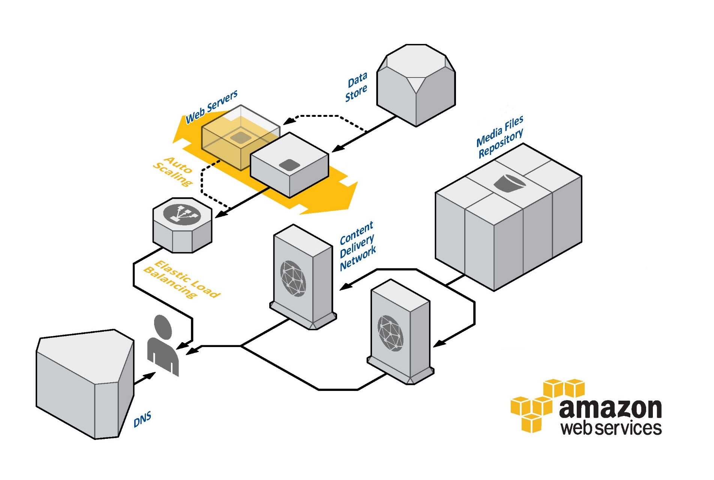
Elastic Load Balancing

Slide 46
Region Vs Availability zones
➢
➢
An AWS region contains two or more availability zones.
Each zone is basically a separate datacenter, and provides low latency connectivity to all other zones in the region.
EC2 instances, reside in the region of your choice. The
➢
AWS regions are isolated from
seamlessly manage resources
each other, but you can
in
different
availability
zones
within
the
same
region.
.

Slide 47
AWS Regions & Availability Zones
US REGIONS
GLOBAL REGIONS
US East (VA)
US West (CA)
Asia Pacific (Tokyo)
Asia Pacific (Singapore)
Availability Zone A
Availability Zone B
Availability Zone A
Availability Zone B
Availability Zone A
Availability Zone B
Availability Zone A
Availability Zone B
Availability Zone C
Availability Zone D
Availability Zone C
US West (OR)
GovCloud (OR)
EU (Ireland)
South America (Sao Paulo)
Asia Pacific (Sydney)
Availability Zone A
Availability Zone B
Availability Zone A
Availability Zone B
Availability Zone A
Availability Zone B
Availability Zone A
Availability Zone B
Availability Zone A
Availability Zone B
Availability Zone C
Availability Zone C
Customer Decides Where Applications and Data Reside
Note: Conceptual drawing only. The number of Availability Zones may vary.

Slide 48
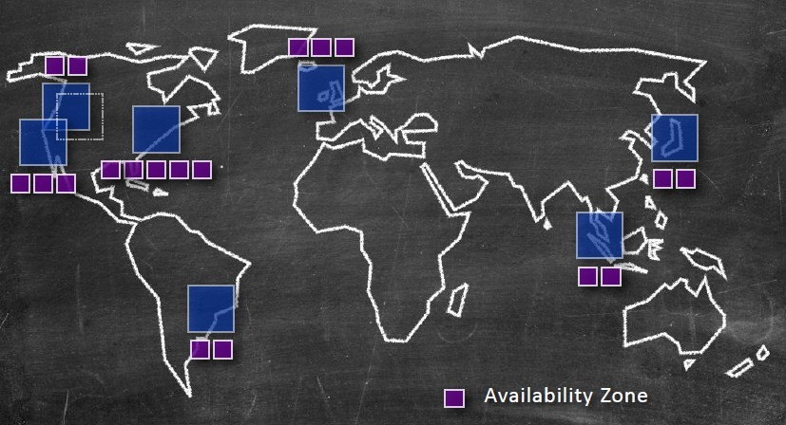
Availability
zones
.

Slide 49
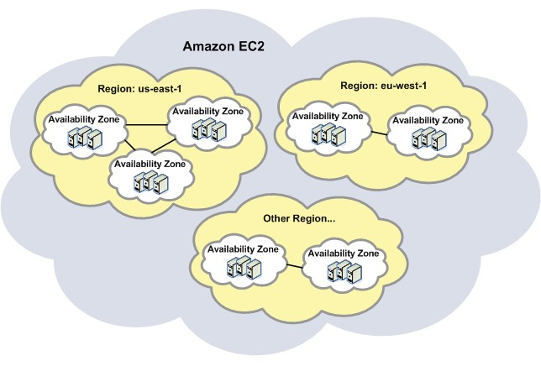
Availability
Zones
(Amazon
EC2)
.

Slide 50
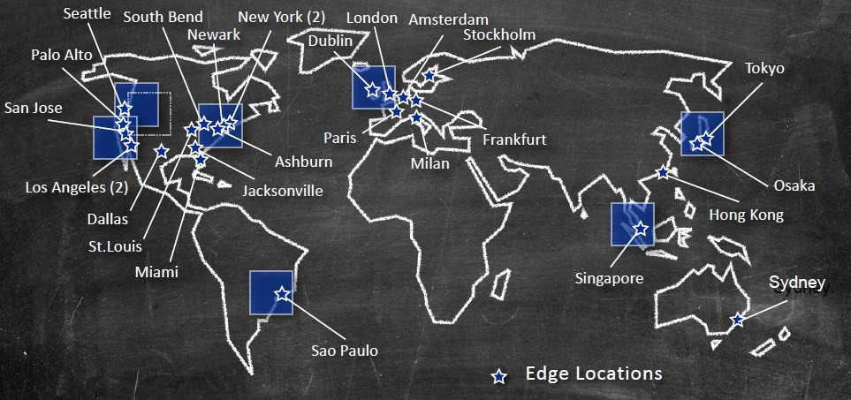
Amazon
Edge
location
.

Slide 51
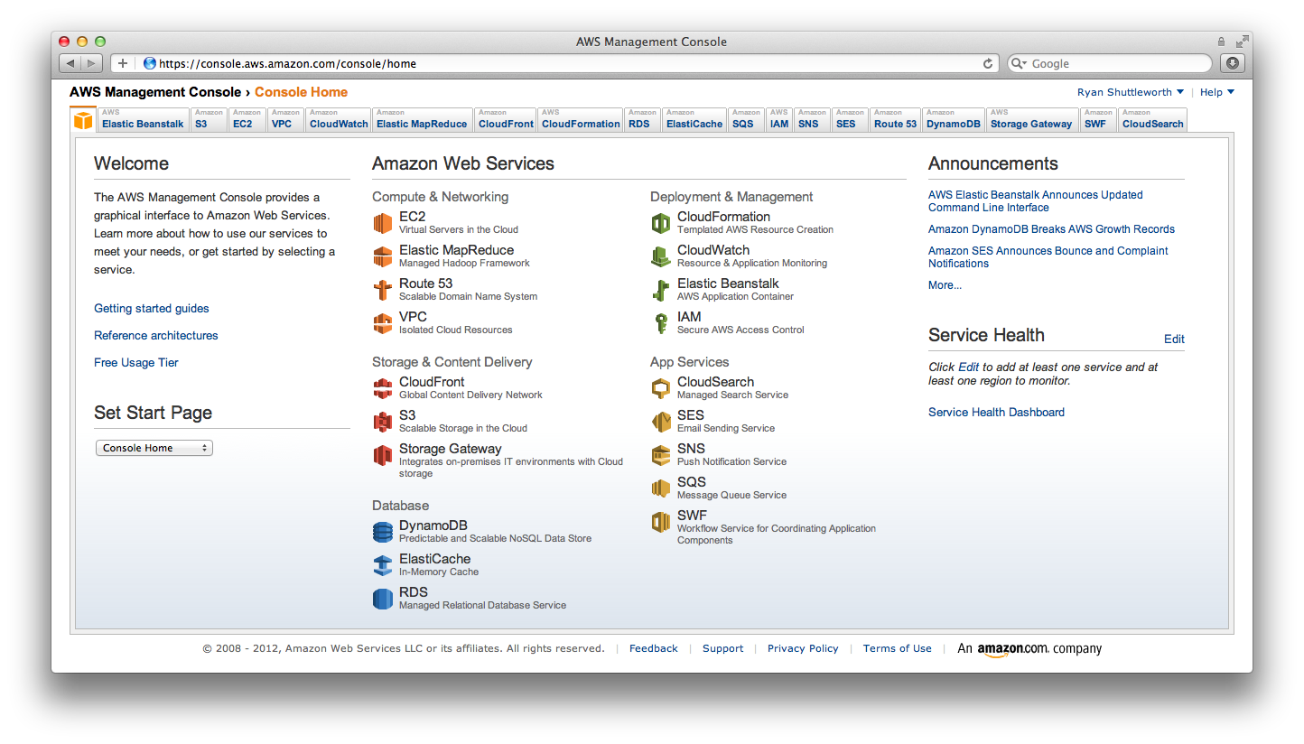
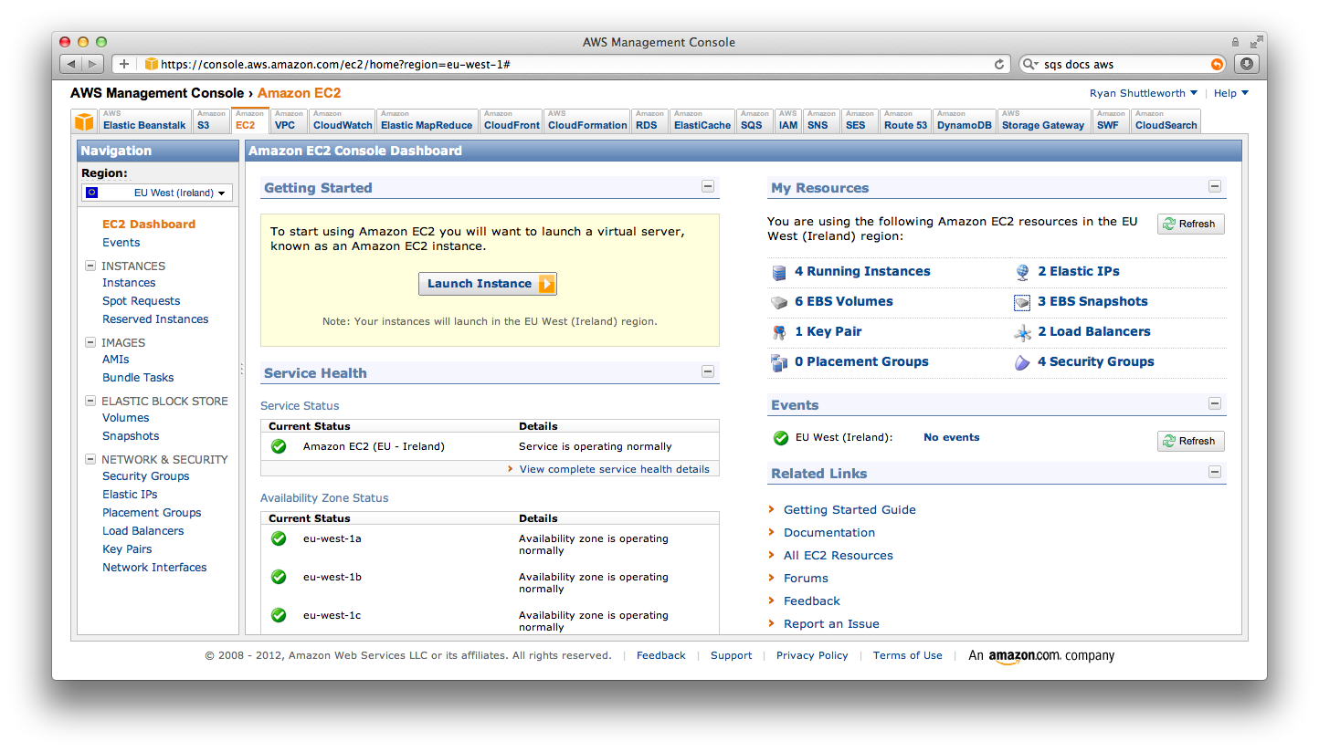
Web Console
On-demand, Self Service Management Access
Notes:
The AWS Management Console provides a point-and-click web interface for Amazon Web Services. Log in using your AWS account name and password. If you’ve enabled AWS Multi-Factor Authentication, you will be prompted for your device’s authentication code.

Slide 52
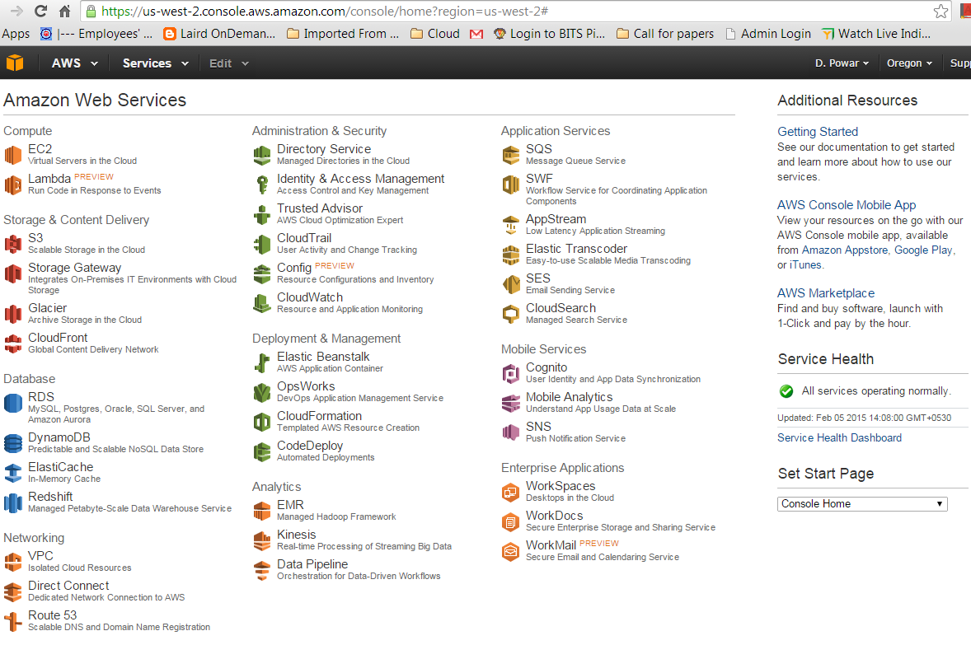
.

Slide 53
Storage
S3
Storage Gateway
EBS
G
Glacier
Notes:
No Notes

Slide 54
Simple Storage Service (S3)
Web-scale Internet Storage
A “Bucket” is equivalent to a “folder”
Able to store unlimited number of Objects in a Bucket
Objects from 1B-5 TB; no bucket size limit
Highly available storage for the Internet (object store)
HTTP/S endpoint to store and retrieve any amount of data, at any time, from anywhere on the web
Highly scalable, reliable, fast, and inexpensive
Ideal Use Cases:
Static web content – often used with CloudFront CDN
Source and output storage for large-scale “Big Data” analytics
Backup, archival, and DR storage that is always “live”
Notes:
Storage for the Internet. Natively online, HTTP/HTTPS access
Store and retrieve any amount of data, any time, from anywhere on the web
Highly scalable, reliable, fast and durable 11 nines of durablity.
11 nines of durability - Designed to provide 99.999999999% durability and 99.99% availability of objects over a given year. Designed to sustain the concurrent loss of data in two facilities.
NOT POSIX…

Slide 55
Objects in Amazon S3
2 Trillion
Time Sequence of Total Number of Objects Stored in Amazon Simple Storage Service (S3)
1.3 Trillion
Current Peak Rate:
1.1 Million Requests per Second
762 Billion
262 Billion
40 Billion
102 Billion
2.9 Billion
14 Billion

Slide 56
Elastic Block Store (EBS)
EBS Volumes = Virtual Disks
Use for persistent storage
Can use to create RAID configuration for a server
Off-instance block storage that persists independently
Storage volumes for use with Amazon EC2 instances – create, attach, backup, restore and delete
Can be attached to a running Amazon EC2 instance and exposed as a block device for raw or formatted (filesystem) access
Volumes behave like unformatted block devices for Linux or Windows instances
Ideas use cases:
OS Boot device / root file system; secondary volumes/filesystems
Typical basis for database storage
Raw block devices for RAID, some databases
Notes:
Block storage volumes for use with Amazon EC2 instances
Attach to running instance and expose as a block device
Off-instance storage that persists independently of EC2 instances
Snapshots stored durably in S3
Block level device – like SAN. Format or encrypt however you like. Run RAID across multiple volumes for better I/O performance

Slide 57
AWS Glacier
G
A low-cost storage service for data archiving and backup
$0.01 per GB / Month
Optimized for data that is infrequently accessed
Retrieval times measured in hours not days or weeks
Annual durability of 99.999999999% for an archive
AES 256 data at rest encryption
Data stored as archives within a vault. Vaults are located within a specific AWS region
Notes:
Amazon Glacier is an extremely low-cost storage service that provides secure and durable storage for data archiving and backup. In order to keep costs low, Amazon Glacier is optimized for data that is infrequently accessed and for which retrieval times of several hours are suitable. With Amazon Glacier, customers can reliably store large or small amounts of data for as little as $0.01 per gigabyte per month, a significant savings compared to on-premises solutions.
You store data in Amazon Glacier as archives. An archive can represent a single file or you may choose to combine several files to be uploaded as a single archive. Retrieving archives from Amazon Glacier requires the initiation of a job. Jobs typically complete in 3 to 5 hours. You organize your archives in vaults. You can control access to your vaults using the Amazon Identity and Access Management (IAM) service.
To use Amazon Glacier you simply:
Use the AWS Management Console or the Amazon Glacier APIs to create vaults. You use vaults to organize the archives you upload to Glacier.
Use the simple Amazon Glacier APIs to upload and retrieve archives.
Monitor the status of your Amazon Glacier jobs using the Amazon Glacier APIs. You can also, optionally, configure your vault to send you a notification via the Amazon Simple Notification Service (Amazon SNS) when your jobs complete.
Pay for what you use. Your monthly bill is based on the amount of data stored and transferred.

Slide 58
AWS Storage Gateway
Storage gateway service connects an on-premise software appliance with cloud-based storage
On-premises software appliance solution to store data on Amazon S3’s storage infrastructure
Exposes standard iSCSI interface to on-premises applications, while maintaining low-latency data access
Data in Amazon S3 stored as Amazon EBS snapshots for local & EC2-based recovery
Use Cases
Backup/Restore on-premise data
Set up a test/dev environment with production data
Migrating applications to the cloud
On-premise DR/COOP to AWS
Notes:
Connect an on-premises software appliance with cloud-based storage.
Securely upload data to the AWS cloud for cost effective backup and rapid disaster recovery
Back up point-in-time snapshots of your on-prem application data to S3 for future recovery
Mirror your on-prem data to EC2 instances
The AWS Storage Gateway is a service connecting an on-premises software appliance with cloud-based storage to provide seamless and secure integration between an organization’s on-premises IT environment and AWS’s storage infrastructure.

Slide 59
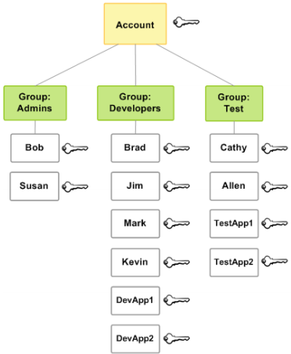
Identity & Access Management
IAM enables customers to create and manage users in AWS’s identity system
Identity Federation with local directory is an option for enterprises
Very familiar security model
Users, groups, permissions
Allows customers to
Create users
Assign individual passwords, access keys, multi-factor authentication devices
Grant fine-grained permissions
Optionally grant them access to the AWS Console
Organize users in groups
Notes:
AWS Identity and Access Management (IAM) enables you to securely control access to AWS services and resources for your users. IAM enables you to create and manage users in AWS, and it also enables you to grant access to AWS resources for users managed outside of AWS in your corporate directory. IAM offers greater security, flexibility, and control when using AWS.
IAM enables identity federation between your corporate directory and AWS services. This enables you to use your existing corporate identities to grant secure and direct access to AWS resources, such as Amazon S3 buckets, without creating a new AWS identity for those users. To learn more about configuring identity federation with your corporate directory, try out our sample application.

Slide 60

Case Study – New York Times
150 years of newspaper to the public online
Challenge:
4 TB of data
405.000 very large TIFF images
3.3 million SGML articles
405.000 XML mapping files
Convert to:
810.000 PNG images
405.000 JavaScript file
Imagine a couple of seconds per conversion → easily 1 month of work!
NYT did it in 36 hours using hundreds of AWS instances (using EC2, S3 and Hadoop)
© 2008 . All rights reserved
60
Notes:
Timesmachine needed infrastructure to host several terabits of data
• Internal IT rejected due to cost
• Business owners got the data up on cloud for $50 over one weekend

Slide 61






When is Cloud Computing A Fit For The Enterprise?
Applications & processes have highly variable demand
High compute capacities are required to accelerate information discovery and publishing
Time-constrained or event-based infrastructure is required to ramp quickly and be disposed of shortly afterwards
Speed of provisioning is constraining business execution
Existing hardware has reached end of serviceable life and refresh options are being considered
Internal datacenter capacity limits are being reached and hosting
locations must be re-balanced
Notes:
61

Slide 62






Where Are Some of The Challenges of Adopting Cloud?
Security on the cloud
Cloud Vendor lock-in: Interoperability
Absence of robust SLAs, Availability and Reliability
Licensing models aren't adapting quickly enough
Increase usage of Internet bandwidth
Making apps publicly available, Interfacing and data volumes
Some architectures require re-working to move to the cloud
Notes:
Security: Compliance/regulatory laws mandate on-site ownership of data
62

Slide 63
Amazon Architecture
Customer Data
Customers implement their own set of controls
Multiple customers with FISMA Low and Moderate ATOs
Platform, Applications, Identity & Access Management
Customer
Operating System, Network & Firewall Configuration
Client-side Data Encryption & Data Integrity Authentication
Server-side Encryption
(File System and/or Data)
Network Traffic Protection
(Encryption/Integrity/Identity)
Foundation Services
SAS-70 Type II
ISO 27001/ 2 Certification
Payment Card Industry (PCI)
Data Security Standard (DSS)
NIST Compliant Controls
DoD Compliant Controls
FedRAMP Compliant Controls
HIPAA and ITAR Compliant
Compute
Storage
Database
Networking
Amazon
AWS Global Infrastructure
Availability Zones
Edge Locations
Regions
Notes:
Since AWS and its customers share control over the IT environment, both parties have responsibility for managing the IT environment. AWS’ part in this shared responsibility includes providing its services on a highly secure and controlled platform and providing a wide array of security features customers can use. The customers’ responsibility includes configuring their IT environments in a secure and controlled manner for their purposes. While customers don’t communicate their use and configurations to AWS, AWS does communicate its security and control environment relevant to customers. AWS does this by doing the following:
• Obtaining industry certifications and independent third party attestations described in this document
• Publishing information about the AWS security and control practices in whitepapers and web site content
• Providing certificates, reports, and other documentation directly to AWS customers under NDA (as required)

Slide 64
AWS Platform
Your Applications
Management & Administration
Identity & Access
AWS IAM
Identity Federation
Consolidated Billing
Web Interface
Management Console
Monitoring
Amazon CloudWatch
Deployment & Automation
AWS Elastic Beanstalk
AWS CloudFormation
Application Platform Services
Content Distribution
Amazon CloudFront
Application Svcs
Simple Workflow Service
CloudSearch
Amazon SNS, SQS, SES
Parallel Processing
Elastic MapReduce
Libraries & SDKs
Java, PHP, Python,
Ruby, .NET
Foundation Services
Compute
Amazon EC2
Auto Scale
Storage
Amazon S3
Amazon EBS
Amazon StorageGateway
Database
Amazon RDS
Amazon SimpleDB
Amazon ElastiCache
Amazon DynamoDB
Networking
Amazon VPC Elastic Load Balancing
Amazon Route 53
AWS Direct Connect
Availability Zones
Edge Locations
AWS Global Infrastructure
Regions
Notes:
Amazon Web Services provides highly scalable computing infrastructure that enables organizations around the world to requisition compute power, storage, and other on-demand services in the cloud. These services are available on demand so a customer doesn’t need to think about controlling them or maintaining them. Customers access the services when they need them and pay for only what they use. One of the primary benefits of the AWS cloud is that it enables companies of all sizes to focus on the differentiating factors of their business as opposed to the infrastructure required to run it.

Slide 65
Amazon’s Infrastructure Web Services
Elastic Compute Cloud (EC2)
Unlimited computing power via virtual machines
Simple Storage Service (S3)
Unlimited persistent storage
Simple Queue Service (SQS)
Simple, reliable messaging
SimpleDB (EBS)
Store and query structured data

Slide 66
Perspective
Getting started
Things to look out for
Helping developers get through early adoption of AWS
Look at concepts and get hands-on
Will use a number of tools
Command-line
Management Console

Slide 67
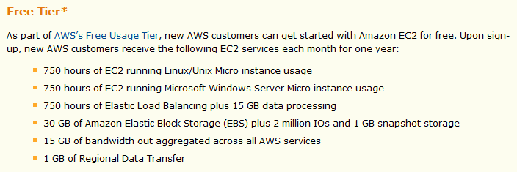
Enticing New Customers

Slide 68
AWS Architecture Training - EC2 (Elastic Compute Cloud)
Module 06 – EC2 – Elastic Compute Cloud

Slide 69
EC2 Features
Resizable Compute Capacity As much as you need, when you need it. Scale up or down in minutes.
Complete Control via API Create, scale, & manage instances programmatically.
Variety of Instance Sizes CPU Power, Cores, RAM, Disk.
Wide Variety of Pre-built AMIs (Amazon Machine Images) Hit the ground running with minimal system building effort. Now: Linux Windows, and OpenSolaris.
Secure & Flexible Network Security Model Full control of access for each running instance. Keypair required for SSH access.

Slide 70
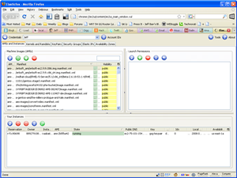
EC2 Architecture
Multiple Regions
Multiple EC2 Availability Zones
S3 Storage
Idle EC2 Instance
Amazon Machine Image
Active EC2 Instance
Elastic Block Storage Volume

Slide 71

EC2 Vocabulary - 1
Region Data center location.
Availability Zone Independent functional partition within a region.
Instance Running machine (virtual slice of real machine).
AMI - Amazon Machine Image Pre-configured system image stored in Amazon S3.

Slide 72
EC2 Vocabulary - 2
EBS Elastic Block Storage.
EBS Volume Unit of EBS Storage – 1 GB to 1 TB / volume.
Elastic IP Address Long-term IP address which can be mapped to any EC2 instance.
ElasticFox EC2 management tool hosted in Firefox.

Slide 73
EC2 Vocabulary - 3
API Tools Command line tools to manage (start, stop, secure) EC2 instances.
AMI Tools Command line tools to create and manage EC2 AMIs.
SSH Secure Shell Protocol – for remote access to EC2 shells.
PuTTY Popular open source SSH client; great for EC2 access.

Slide 74
Virtual Machine Choices
 | Standard |  |  |  | High CPU
 | Small | Large | Extra Large |  | Medium | Extra Large
Bits | 32 | 64 | 64 |  | 32 | 64
RAM | 1.7 GB | 7.5 GB | 15 GB |  | 1.7 GB | 7 GB
Disk | 160 GB | 850 GB | 1690 GB |  | 350 GB | 1690 GB
EC2 Compute Units | 1 | 4 | 8 |  | 5 | 20
I/O Performance | Medium | High | High |  | High | High
Firewall | Yes | Yes | Yes |  | Yes | Yes
Linux Per Hour | $0.10 | $0.40 | $0.80 |  | $0.20 | $0.80
Windows Anon | $0.125 | $0.50 | $1.00 |  | $0.30 | $1.20
Windows Authenticated | $0.25 | $0.75 | $1.50 |  | $0.50 | $2.00
Note: All prices slightly higher in Europe

Slide 75

EC2 Regions
Currently, 2 regions:
US-East (3 availability zones)
EU-West (2 availability zones)
More regions planned for the future
Zones are totally separate and distinct
EC2 artifacts must be moved between zones:
Keys
AMIs
Security groups

Slide 76

EC2 Instance Lifecycle
Instance is idle.
Run Instances call to cloud (status: pending):
Cloud finds idle instance.
AMI copied from S3 to instance’s local disk.
Instance booted.
Instance is active (status: running).
Instance begins to shut down (status: shutting-down).
Instance terminates (status: terminated).

Slide 77
EC2 Network Security 1
Control Access:
Outside world to EC2
EC2 instance to EC2 instance
For Example:
Web Server
App Server
DB Server
Web Server (80)
SSH (22)
App Server (2048)
SSH (22)
DB Server (3300)
SSH (22)

Slide 78
EC2 Network Security 2
Secure by default
Open ports as needed
Default group:
Port 80
(HTTP)
EC2 Firewall
Port 22
(SSH)
EC2 Instance

Slide 79

EC2 Network Security 3
Concepts:
Inbound access control only
Security group – collection of access rules
Assign group(s) on instance launch
Modify existing group on running instances
Access rule:
Name
Description
Protocol
Port range
IP Address range

Slide 80
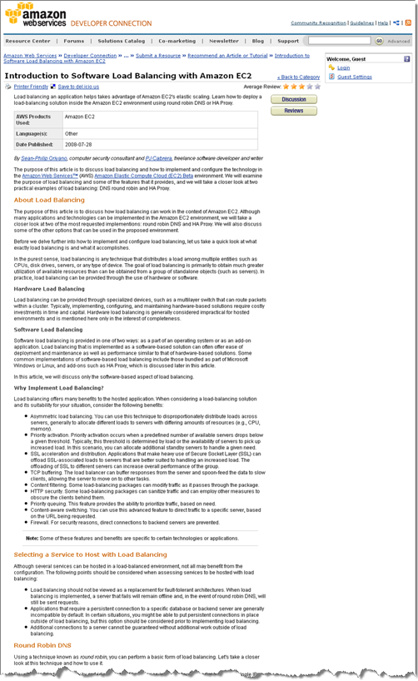
EC2 Instance Addressing
Every instance gets:
Private IP adddress
Private DNS name (*.internal)
Public DNS name (*.amazonaws.com)
Optional public IP addresses
Attach IP address to any running instance
Load balancing:
Round-robin DNS
HA Proxy & Heartbeat
Good article in AWS Resource Center

Slide 81
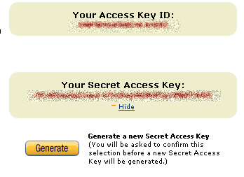
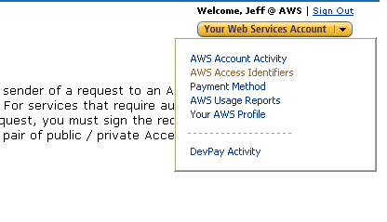
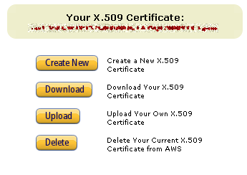
EC2 Instance Security
Keys & X.509 Cert generated at aws.amazon.com

Slide 82
EC2 API Overview
CreateVolume –
Create an EBS volume of any size (1 GB to 1 TB).
Images:
RegisterImage
DescribeImages
DeregisterImage
ModifyImageAttribute
DescribeImageAttribute
ResetImageAttribute
Instances:
RunInstances
DescribeInstances
TerminateInstances
GetConsoleOutput
RebootInstances
IP Addresses:
AllocateAddress
ReleaseAddress
AssociateAddress
DisassociateAddress
DescribeAddresses
Keypairs:
CreateKeyPair
DescribeKeyPairs
DeleteKeyPair
Security Groups:
CreateSecurityGroup
DescribeSecurityGroups
DeleteSecurityGroup
AuthorizeSecurityGroupIngress
RevokeSecurityGroupIngress
Block Storage Volumes:
CreateVolume
DeleteVolume
DescribeVolumes
AttachVolume
DetachVolume
CreateSnapshot
DescribeSnapshots
DeleteSnapshot
AttachVolume –
Attach an EBS volume to a running EC2 instance.
AssociateAddress –
Associate public IP address with a running EC2 instance.
DescribeImages –
Fetch a list of all available Amazon Machine Images (AMIs).
RunInstances –
Launch any number of AMIs on available hardware.

Slide 83

EC2 Tools Overview
Command Line Tools
API Tools
AMI Tools
Graphical Tools
ElasticFox
Cloud Studio
Jollat
Management As A Service
RightScale
Scalr.Net

Slide 84
EC2 Command Line Tools
API Tools
Access EC2 API functionality from command line.
Cross-platform (Java).
Tools go 1-for-1 with API calls.
Environment variables for private key and cert.
AMI Tools
Specialized tools for creating new AMIs.
Bundle image.
Upload image.

Slide 85
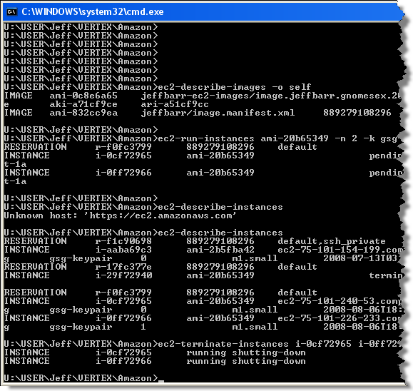
EC2 Command Line Tools - 1
ec2-describe-images Display list of available AMIs, all or by owner.
ec2-add-keypair Create and display a new keypair.
ec2-run-instances Launch any number of instances of an AMI.
ec2-authorize Authorize network access by port / IP.
ec2-describe-instances Display list of running instances.
ec2-terminate-instances Terminate running instances.

Slide 86
EC2 Command Line Tools - 2
set JAVA_HOME=C:\Program Files\Java\jre1.5.0_09
set EC2_HOME=C:\ec2-api-tools-1.3-19403
set PATH=%PATH%;%EC2_HOME%\bin
set EC2_PRIVATE_KEY=U:\user\jeff\vertex\amazon\ pk-5NFGWYPX57GD4SRRIGYAJ5QI2DRPFFK3.pem
set EC2_CERT=U:\user\jeff\vertex\amazon\ cert-5NFGWYPX57GD4SRRIGYAJ5QI2DRPFFK3.pem
ec2-run-instances ami-20b65349 -n 1 -k gsg-keypair

Slide 87
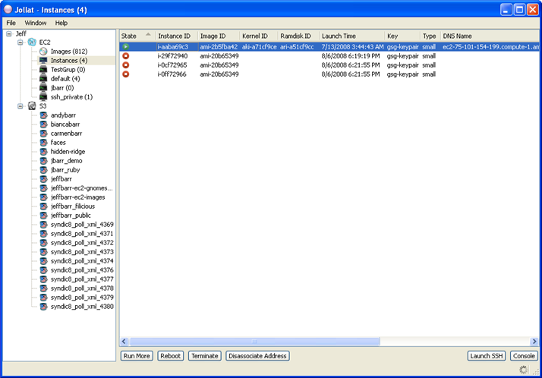
Third-Party EC2 Tools - 1
Jollat – www.jollat.com
Desktop application.
Windows, Mac, Linux.
Java, cross-platform.
EC2 and S3 management.
Free trial, $66 to keep.
Multiple Accounts.

Slide 88
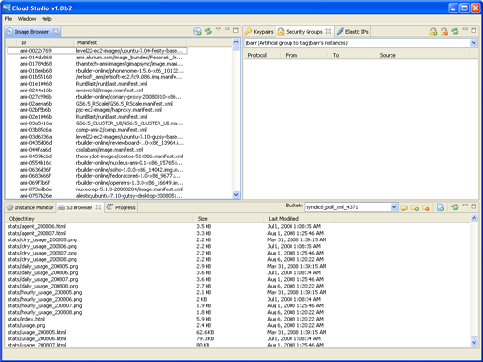
Third-Party EC2 Tools - 2
Cloud Studio – www.service-cloud.com
Desktop application.
Windows & Mac.
Java, cross-platform.
Standalone or Eclipse.
EC2 and S3 management.

Slide 89
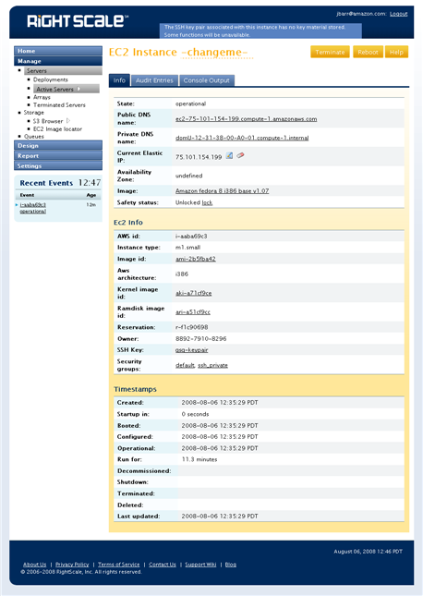
Third-Party EC2 Tools - 3
RightScale Dashboard – www.rightscale.com
Management-as-a-Service.
EC2, S3, SQS management.
Higher-level tool:
Cluster definition.
Cluster management.
Monitoring.
Dynamic dashboard.
Policy-driven scaling.
Server launch templates.
Free & paid versions.

Slide 90
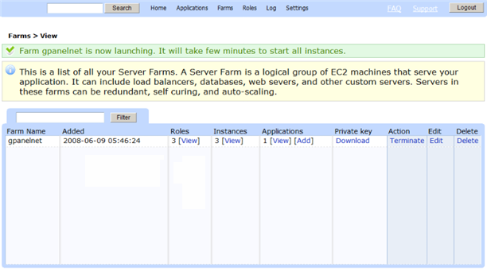
Third-Party EC2 Tools 4
Scalr – www.scalr.net
Management-as-a-Service.
EC2 management.
Higher-level tool:
Auto-scaling server farm.
Prebuilt AMIs:
Load balancer
MySQL master or slave
Application server

Slide 91

EC2 System Building Options
Prebuilt AMI
Large catalog (over 1000 entries).
Quality, support, documentation will vary.
Custom AMI
Build from scratch, to exact specs.
Bundle, share, reuse.
More info on next slide.
Puppet (open source)
Simplify process of distributing files to a collection of machines.
Driven by specification language.
rPath rBuilder (Commercial product)
Repeatably create custom software appliances with full control of versioning and dependencies.

Slide 92

EC2 AMI Construction Process
Choose base image & boot on EC2.
Install:
System software
Application software
Reference data
Test
Create EC2 bundle
Upload bundle to S3
Register bundle
Use / reuse
Maintain (track security issues & updates)

Slide 93
EC2 FAQ
Load balancer? Most developers implement their own using an open source load balancer such as Nginx or Pound. Amazon product announced for 2009; details TBD.
Automatic scaling?
RightScale and Scalr do this now. Amazon product announced for 2009; details TBD.
Additional data center locations? We don’t discuss in public, but planning for West coast of US and then Europe.
Security? White paper available.
Certifications? Working on SOX and SAS-70.

Slide 94
Questions?

Slide 95
Amazon EC2
EXCERCISE

Slide 96
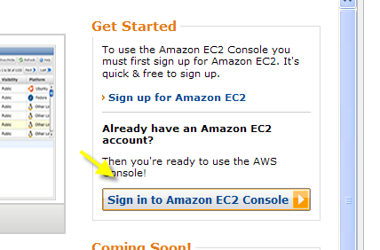
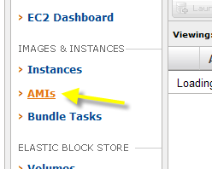
Amazon EC2 Console
Navigate to https://console.aws.amazon.com/
Sign into the Amazon EC2 Console
Click on the AMIs option

Slide 97
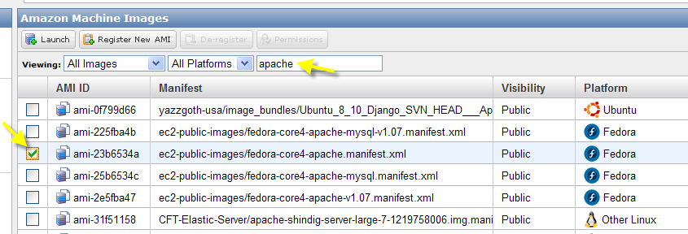
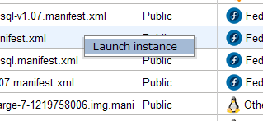
Amazon EC2 Console
Type ‘apache’ in the text box shown and press RETURN
Select the AMI shown (ami-23b6534a); launch

Slide 98
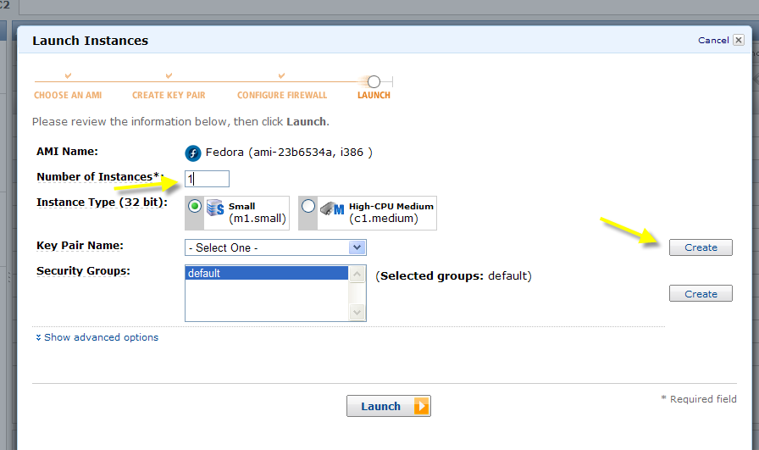
Amazon EC2 Console
Enter ‘1’ as the number of instances and create a new key-pair

Slide 99
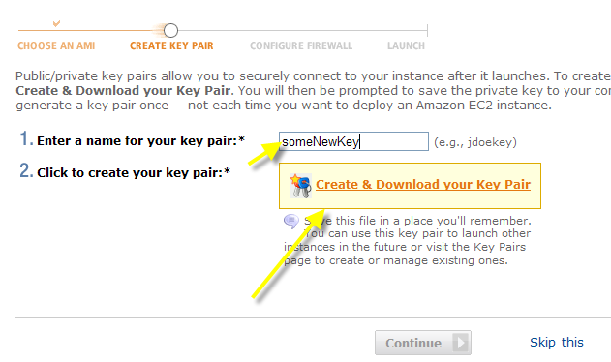
Amazon EC2 Console
Enter any value for the key
Create and download your key
Press ‘Continue’

Slide 100
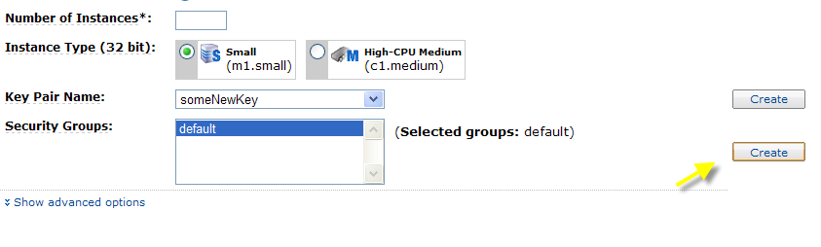
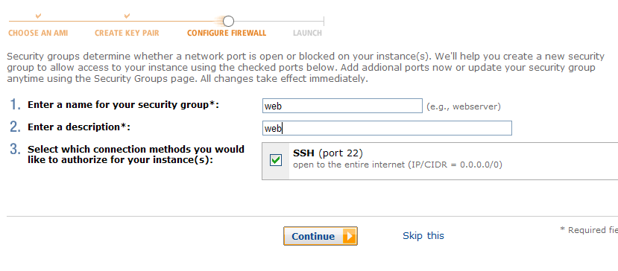
Amazon EC2 Console
Create a new security group
Enter a name as shown (‘web’ or something like that)
Press ‘Continue’

Slide 101
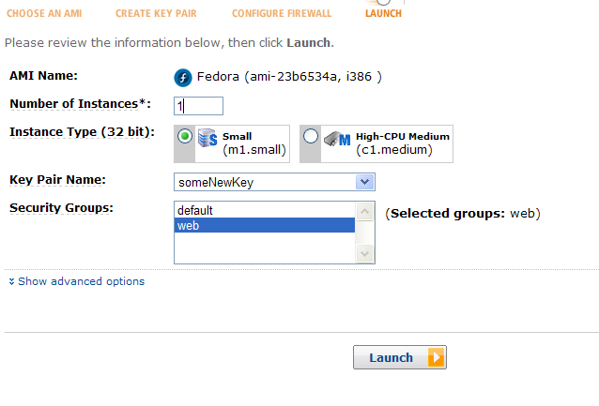
Amazon EC2 Console
Launch with the web security group

Slide 102
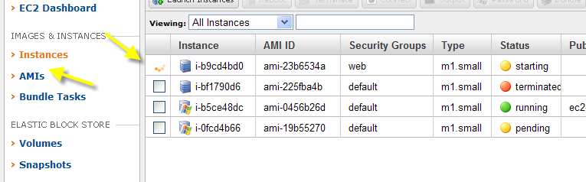
Amazon EC2 Console
Go to the ‘Instances’ option
Notice your instance running

Slide 103
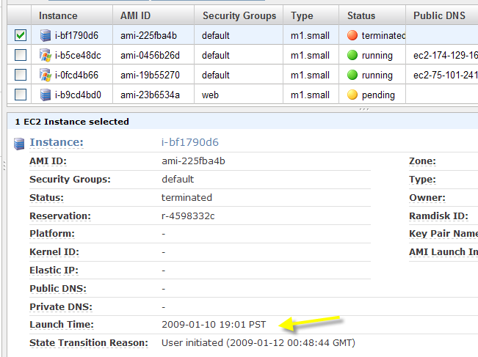

Amazon EC2 Console
Select and notice the ‘Launch Time’

Slide 104
Amazon EC2 Console
Repeat for the following
Search for ‘Windows’ and launch
Search for ‘ami-eXXXXXX’ and launch it

Slide 105
EC2 : CONCEPTS
THEORY

Slide 106
AWS EC2 Life Cycle Management
Find an AMI
Launches an instance based on that AMI
Modify the instance (i.e. install software)
Use instance (i.e. compute data)
Save and publish a new AMI
Launch an instance based on new AMI
Cycle repeats…

Slide 107
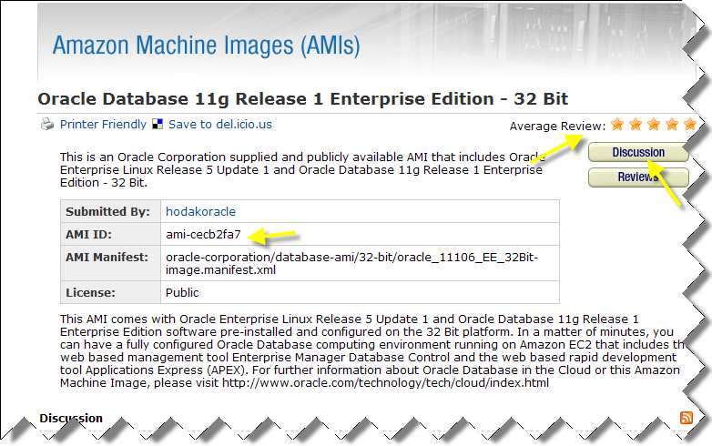
Find an Amazon Machine Image
Amazon-registered community AMIs
http://developer.amazonwebservices.com/connect/kbcategory.jspa?resultOffset=45&categoryID=101

Slide 108
Find an Amazon Machine Image
‘Private’
Images that you create and are only visible to you (via API, tools and/or consoles)
‘Shared’
Images for which you have launch permissions; typically someone gives you an id (i.e. ami-cecb2fa7)
‘Public’
Submit via http://developer.amazonwebservices.com/connect/entryCreate!default.jspa?categoryID=114&entryTypeID=2
Choose ‘AMI’ as the document type
‘Paid’
Available via a contract from a service provider – payment is typically done via Amazon Dev/FlexPay

Slide 109
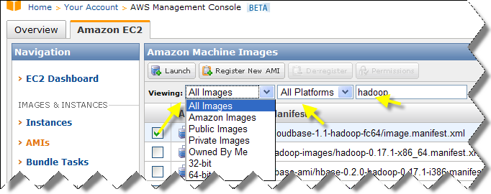
Find an Amazon Machine Image
Search is somewhat primitive at this point; basic keywords in the manifest

Slide 110
Find an Amazon Machine Image
Factors in choosing which AMI to use
Architecture
See http://aws.amazon.com/ec2/instance-types/
64-bit AMI needs to be run on 64-bit instance type
Default is small-instance which is 32-bit
Windows
With and without Authentication Services
12.5 cents/hour versus 25 cents/hour

Slide 111
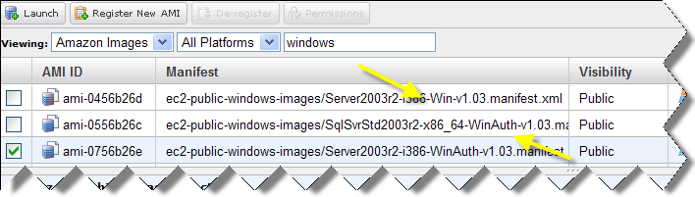
Windows Authentication Services
If you need more than 5 concurrent users (i.e. Windows Accounts) or if you are using LDAP, Kerberos, RADIUS, or other credential services
Microsoft Exchange Server
Microsoft SharePoint® Server, or other applications that require end-user authentication.
Using IIS as a public web server does not require Authentication Services

Slide 112
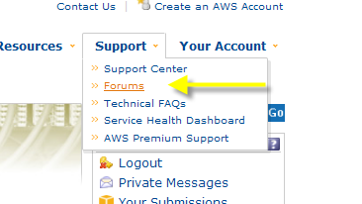
AMI Updates
Updates are announced on the user forums

Slide 113
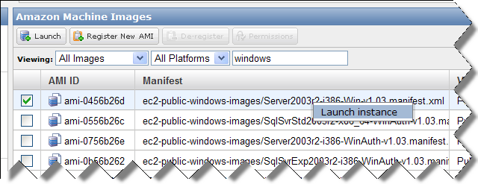
Launch an Instance
Default choices are most likely not suitable
Choices to make
Key-Pair
Availability Zone
Number of instances to launch
Security Group
more on this later
Launch metadata
more on this later
Alternate kernels and ramdisks

Slide 114
Launch an Instance – Key Pairs
Key pairs are X.509 certificates
Amazon keeps the public certificate
You keep the secret
Same type as your credential certificates, but different purpose
If no key pair is specified, your instance will still run, but you will not be able to access it (i.e. via RDP or SSH)

Slide 115
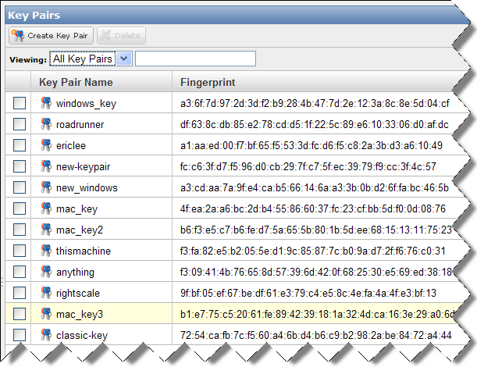
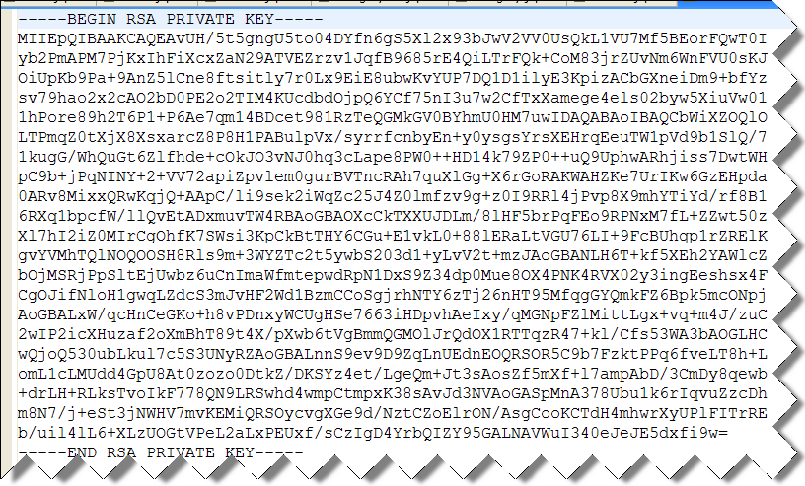
Launch an Instance – Key Pairs
You can have as many key pairs as you would like
When you create a key pair, you have to save the private key; this is your only chance
These private keys must be carried between machines
Easy to lose private keys*

Slide 116
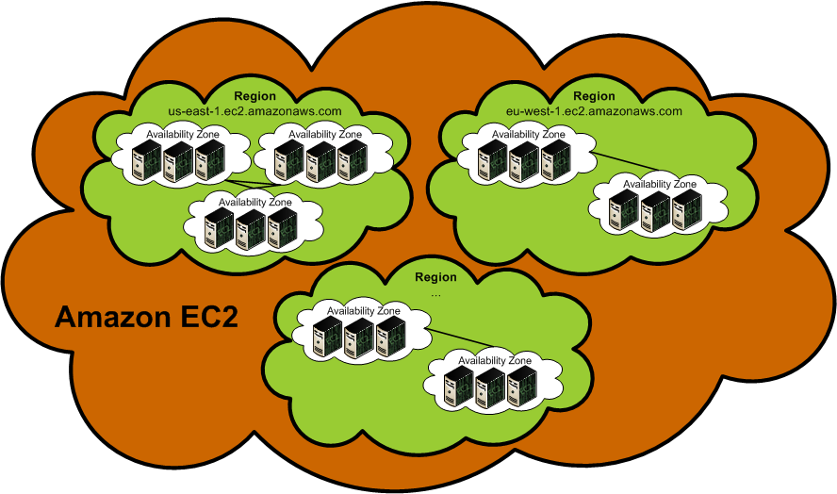
Launch Instance – Regions and Availability Zones

Slide 117
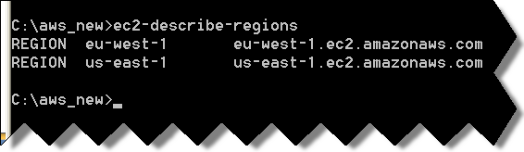
Launch Instance – Regions
2 AWS Regions
European Union
United State
Regions are completely isolated – gives you maximum failure independence and stability
Choosing EU versus USA gives you better locality with your customers
Change URL endpoint work with a region
Change EC2_URL for command-line
Alter URL for API

Slide 118



Launch Instance – Availability Zones
Availability Zones provide some isolation within a region while still optimizing network latency
Availability Zones are not the same across accounts
us-east-1a for account A is not necessarily the same as us-east-1a for account B
Zone assignments are mapped independently for each account.
Best practice is to let Amazon pick for you
Always a good idea to monitor the distribution
Instance Availability Zone and EBS must be synchronized

Slide 119
Launch Instance – Regions and Zones
AMIs | Regional | AMIs are tied to the region where its files are located within Amazon S3.
Security Groups | Regional | Security groups are not copied across regions. Instances within the region cannot communicate with instances outside the region using group-based firewall rules. Traffic from instances in another region is seen as WAN bandwidth.
SSH Key Pairs | Regional | Key pairs (to connect to instances) are region-specific.
User-Supplied Identifiers | Regional | Includes security group names, SSH key pair names, and so on. Although you can create the same names in multiple regions, they have no relationship to each other.
Elastic IP Addresses | Regional | Elastic IP addresses are tied to a region and cannot be mapped across regions.
EBS Volumes | Availability Zone | An Amazon EBS volume must be located within the same Availability Zone as the instance to which it attaches.
EBS Snapshots | Regional | Snapshots are tied to regions and can only be used for volumes within the same region.

Slide 120

Launch Instance – Regions and Zones
Data Transfer costs to consider
http://aws.amazon.com/ec2/#pricing

Slide 121
Launch Instances – Regions and Zones
When data is transferred between regions, charges are incurred

Slide 122

Launch Instance – Regions and Zones
Data transfer is free between instances in the same zone when private IP addresses are used
Otherwise, data transfer is $.01/GB and you lose performance
Always use private IP addresses between EC2 instances in the same zone*
Data transfer in/out between instances in different zones in the same region - $.01/GB

Slide 123
Launch Instances - Addressing Instances
Instances are given a dynamic IP by default
Amazon Elastic IP provides a static IP that you can associate with an instance
Elastic IP addresses incur a charge if they are not associated with an instance
$0.01 per non-attached Elastic IP address per complete hour*

Slide 124
Launch Instance
Windows instances will take longer than Linux-based instances
Consoles may report a Windows instance as ‘running’, but it will not be accessible – just have to wait a few more minutes
Once running, use SSH for Linux and RDP for Windows
More on this later

Slide 125
Launch Instance
Security Group
‘default’ is created for you, can create as many you would like
Instances in the same security group have unlimited network access to each other
Otherwise, it is port-by-port like firewall

Slide 126
Launch Instance
When an instance is launched, meta-data is available
Within the instance, this data is available via http://169.254.169.254/latest
GET http://169.254.169.254/2008-12-01/meta-data/product-codes
774F4FF8

Slide 127
Data | Description
ami-id | The AMI ID used to launch the instance.
ami-launch-index | The index of this instance in the reservation (per AMI).
ami-manifest-path | The manifest path of the AMI with which the instance was launched.
ancestor-ami-ids | The AMI IDs of any instances that were rebundled to create this AMI.
block-device-mapping | Defines native device names to use when exposing virtual devices.
instance-id | The ID of this instance.
instance-type | The type of instance to launch. For more information, see Instance Types.
local-hostname | The local hostname of the instance.
local-ipv4 | Public IP address if launched with direct addressing; private IP address if launched with public addressing.
kernel-id | The ID of the kernel launched with this instance, if applicable.
placement/availability-zone | The Availability Zone in which the instance launched.
product-codes | Product codes associated with this instance.
public-hostname | The public hostname of the instance.
public-ipv4 | The public IP address
public-keys/ | Public keys. Only available if supplied at instance launch time
ramdisk-id | The ID of the RAM disk launched with this instance, if applicable.
reservation-id | ID of the reservation.
security-groups | Names of the security groups the instance is launched in. Only available if supplied at instance launch time

Slide 128

Launch Instance
User-specified data is probably the most interesting

Slide 129
AWS EC2 Life Cycle Management
Find an AMI
Launches an instance based on that AMI
Modify the instance (i.e. install software)
Use instance (i.e. compute data)
Save and publish a new AMI
Launch an instance based on new AMI
Cycle repeats…

Slide 130
working with Windows instances
Exercises

Slide 131
Amazon EC2 - Windows
Go to your running Windows Instance
Select it and press the Password button
Copy in the contents of your private key
Copy the password to notepad

Slide 132
Amazon EC2 - Windows
Select your instance and press the Connect button
Open the RDP file
Write in the password you were given (cut and paste does not work)

Slide 133

Amazon EC2 - Windows
In the resulting window, choose Disk Management

Slide 134
working with Linux instances
Exercises

Slide 135
EC2 Linux Instance
Navigate to https://console.aws.amazon.com/
Sign into the Amazon EC2 Console
Click on the AMIs option

Slide 136


EC2 Linux Instance
Select your instance and choose ‘Connect’
Copy the ssh command
Remember, if you are using Windows, you need a .PPK file (puttygen.exe)
Copy and run the command in your terminal window

Slide 137

EC2 ‘Hello World’
You should SSH-ed into your instance
Type ‘cd /var/www/html’
Type ‘vi index.html’

Slide 138

EC2 Linux Instance
Type ‘ESC’, ‘I’
Type ‘Hello World’
Type ‘ESC’
Type ‘:’
Type ‘wq’

Slide 139


EC2 Linux Instance
Copy the Public DNS value to your clipboard
You should get a timeout error
Select the Security Groups option

Slide 140

EC2 ‘Hello World’
Add HTTP and press Save
Refresh the browser with your public DNS and you should be able to connect and see Linux Instance

Slide 141
working with Linux instances
Exercises

Slide 142

User Management
All AWS users need an Amazon identity

Slide 143


User Management
Signing up for web services is a 2-step process
Create an Amazon identity
Opt into each service you want to use

Slide 144


User Management
Information you need to diagnose a problem
Account Number

Slide 145

User Management
Account Key ID and Secret Access Key
If in doubt, generate a new Secret Access Key
Knowing the Access Key ID on its own cannot really be exploited

Slide 146

User Management
X.509 Certificates
Private keys are easy to lose – need to generate a new X.509 certificate in order to get it

Slide 147


User Management
Usage Reports enable you to see charges to your account
Data can be exported

Slide 148
User Management
Developers will mostly use key and secret in their APIs
When using SOAP with WS-Security, they will need their X.509 Certificates as well
Really common question:
“Can I anonymously use EC2, SQS, SimpleDB?”
Answer is almost always “No”
S3 Query API via ACL is the slight exception

Slide 149
Associate an address with an Instance
Exercise

Slide 150

Elastic IP
Select the Elastic IPs option

Slide 151


Elastic IP
Allocate a new address
Associate this address

Slide 152

Elastic IP
Open this IP address with your browser
Might have to try a few times

Slide 153
AWS EC2 Life Cycle Management
Find an AMI
Launches an instance based on that AMI
Modify the instance (i.e. install software)
Use instance (i.e. compute data)
Save and publish a new AMI
Launch an instance based on new AMI
Cycle repeats…

Slide 154


Amazon EC2 Typical Usage Scenarios
Static Elastic IP address associated with a domain
EC2 instance running a web server associated to Elastic IP address
Identical back-up machine waiting in a ready state

Slide 155

Addressing Instances
Instances are given a dynamic IP by default
Public and Private
Amazon Elastic IP provides a static IP that you can associate with an instance
Costs are associated with Elastic IP, so only use if you need to
ec2-describe-addresses
ec2-allocate-address
ec2-associate-address

Slide 156



Listing Amazon Machine Images
ec2-describe-images command line tool (-o option specifies owner)
DescribeImages SOAP Request
Several management consoles are available

Slide 157
Amazon EC2 Fundamental Operations
ec2-describe-images
List AMIs
ec2-run-instances
Start an AMI
ec2-describe-instances
Check the status of an AMI
ec2-terminate-instances
Stop AMIs

Slide 158
Modify the Instance
Instance Storage
Root (‘/’) on Linux
C:\ on Windows
Up to 10 GB (included OS footprint)
Ephemeral Storage
/mnt on Linux
D:\ on Windows
Size depends on instance type (~160GB)
DATA IS NOT PERSISTED WHEN AN INSTANCE IS SHUTDOWN OR TERMINATED*

Slide 159
Modify the Instance
Install software on instance storage
C:\program files
/usr/bin
10GB is a hard limit
To optimize drive performance, perform a ‘dummy’ write on all volumes
Many options for storing your data…

Slide 160
Modify the Instance
Creating your own AMI is never the wrong choice
It saves your work (as long as it is < 10GB)
Elastic Block Storage and/or S3 is usually the better choice
Look for S3 buckets and EBS volumes*
If there are none created, then instance data is at risk

Slide 161
AWS Architecture Training – EBS Elastic Block Store
Elastic Block Storage - Concept

Slide 162
EBS and S3 -What’s the Difference?
 | Amazon S3 | EBS
Paradigm | Object store | File system
Performance | Very fast | Very, very fast
Redundancy | Across data centers | Within data center
Security | Public Key / Private Key | Visible only to your EC2
Pricing | $0.15/GB stored | $0.10/GB allocated
Access from the Net? | Yes(1) | No(2)
Typical use case | Write once, read many | It’s a disk drive, dude
Only with proper credentials, unless ACLs are world readable
Accessible from Net if mounted to server and set up as FTP, etc.

Slide 163

Module Overview
EBS Features
EBS Architecture
EBS Vocabulary
EBS Pricing
EBS Volume Lifecycle
EBS API & Tools

Slide 164
EBS Features
Persistent storage Volume lifetime is independent of any particular EC2 instance.
General purpose Raw, unformatted, block device. Use from Linux, Solaris or Windows.
High performance Equal to or better than local EC2 drive.
High reliability Built-in redundancy within availability zone. AFR (Annual Failure Rate) between 0.1% and 1%.
Scalable Volume sizes ranging from 1 GB to 1 TB. (20 TB/account limit while in beta)
Easy Easy to create, attach, back up, restore, and delete volumes.

Slide 165
EBS Architecture
EC2 Availability Zone
S3 Storage
Active EC2 Instance
Elastic Block Storage Volume
EBS Volume Snapshot

Slide 166
EBS Vocabulary
EBS Elastic Block Storage.
EBS Volume Unit of EBS Storage – 1 GB to 1 TB / volume.
EBS Snapshot Point-in-time backup saved to Amazon S3.
Block Device Storage medium which responds to open/close/read/write.
Filesystem A structured way to store files on a block device.

Slide 167

EBS Pricing
EBS Volumes
$0.10 per GB-month of provisioned storage
$0.10 per 1 million I/O requests
No charge for mounting/unmounting volume
EBS Snapshots to Amazon S3
$0.15 per GB-month of data stored
$0.01 per 1,000 PUT requests (when saving a snapshot)
$0.01 per 10,000 GET requests (when loading a snapshot)

Slide 168
EBS Volume Lifecycle
Vast amounts of empty space.
Volume created.
Volume attached to running EC2 instance.
Volume formatted with file system.
Volume mounted.
Data stored on volume.
Volume snapshotted to S3.
Volume detached.
Volume deleted.

Slide 169
EBS API Overview
Volumes
CreateVolume – (size/snapshot ID, region, availability zone)
DeleteVolume - (volume ID)
DescribeVolumes - (optional list of volume IDs)
AttachVolume - (volume ID, instance ID, device name)
DetachVolume – (volume ID)
Snapshots
CreateSnapshot - (volume ID)
DeleteSnapshot - (snapshot ID)
DescribeSnapshot - (optional list of snapshot IDs)

Slide 170
EBS Command Line Tools
ec2-create-volume Create an EBS volume.
ec2-attach-volume Attach an EBS volume to an EC2 instance.
ec2-describe-volumes List all volumes.
ec2-create-snapshot Snapshot volume to Amazon S3.
ec2-describe-snapshots Display list of snapshots.
ec2-detach-volume Detach an EBS volume from an EC2 instance.
Ec2-delete-volume Delete an EBS volume.

Slide 171






EBS Support in ElasticFox
List Volumes
List Snapsnots
Create / Delete Volume
Create Volume from Snapshot
Attach Volume to Instance
Snapshot Volume to S3
Delete Snapshot

Slide 172

EBS and RAID
Using RAID striping can yield better performance depending on access patterns.
EBS striping can be done using multiple volumes.
Mirroring data across multiple EBS volumes is unlikely to improve volume durability and can decrease performance.
More frequent snapshots increase durability and provide a backup solution.
Extreme EBS RAID: 40 x 1 TB volumes + RAID 0 = 40 TB RAID = $4K/month

Slide 173
Questions?

Slide 174

Elastic Block Storage
In your console, note that zone your instance is running

Slide 175

Elastic Block Storage
Navigate to Volumes
Create a new Volume

Slide 176

Elastic Block Storage
Choose the matching zone
Pull-down the list of snapshots and notice your choices
Press Create

Slide 177

Elastic Block Storage
In the console, select your new volume and press the Attach button
Choose your running instance and press Attach

Slide 178

Elastic Block Storage
Go to your RDP session and you should see a new disk added

Slide 179

Elastic Block Storage
Right-click and choose Initialize Disk
Right-click again and choose New Partition; take all defaults in resulting dialog. You can take the option to do a quick format
Wait a few moments as the disk is formatted

Slide 180

Elastic Block Storage
When the disk has been formatted, go to the new volume (probably E:\)
Create a new text file
Call it ‘helloworld.txt’

Slide 181
Elastic Block Storage
Go back to console and choose Detach volume
Manually refresh the status until it has been detached

Slide 182
Elastic Block Storage
Repeat this same process with your other Windows instance
Attach the EBS volume and check disk manager
Your helloworld.txt file should be available

Slide 183
EC2 Best Practices
Estimate usage with calculator
http://calculator.s3.amazonaws.com/calc5.html
Check out Amazon Public Datasets
http://aws.amazon.com/publicdatasets/
Remember automation – everything we did can be done programmatically
Start many instances at once
Take advantage of inter-AWS pricing
Transfers between EC2* and S3/SDB/SQS are free
Use the status web site
http://status.aws.amazon.com

Slide 184
AWS EC2 Life Cycle Management
Find an AMI
Launches an instance based on that AMI
Modify the instance (i.e. install software)
Use instance (i.e. compute data)
Save and publish a new AMI
Launch an instance based on new AMI
Cycle repeats…

Slide 185

Save and Publish AMI
Creating an AMI is never the wrong choice
You will not lose data this way
Can always clean up later
1% work, 99% waiting
10GB is a hard limit
Method to create AMI is different for Linux and Windows
The S3 bucket location (EU or US) determines the region where the AMI will be launched
Can always be copied from 1 region to another

Slide 186
Save AMI - Windows
Creating a Windows AMI is easier – everything is done outside of the instance
Most consoles have a ‘bundle’ feature
AMI registration is the same
10GB limit is the same
Use ec2services
Generate password
Mount drives

Slide 187
Save AMI – Linux/UNIX
Create an AMI from an existing AMI
Create your AMI from an AMI that you were using
Arguably the more typical scenario
Create an AMI from a loopback file
Create an AMI from an OS installation
http://docs.amazonwebservices.com/AWSEC2/2008-12-01/DeveloperGuide/ami-via-loopback.html

Slide 188
Save AMI – Linux/UNIX
Upload your AWS private key and certificate
Run ‘bundle-vol’ on the instance
Most AMIs will have these tools installed, if not, get them from
https://s3.amazonaws.com/ec2-downloads/ec2-ami-tools.noarch.rpm
https://s3.amazonaws.com/ec2-downloads/ec2-ami-tools.zip
This operation will take some time
By default, files will be stored on /var/run

Slide 189
Save AMI – Linux/UNIX
Create an S3 bucket (remember US or EU depending on what region you want)
Upload the bundle to your bucket by running ec2-upload-bundle and specifying the manifest file (created by previous operation and stored in /var/run), bucket, secret and key
This operation will take a while as well
Last step is to run ec2-register to get your AMI ID
ec2-register has to be run after a AMI has been copied between regions

Slide 190
Save AMI
After a short period of time, you should have at least a few custom AMIs
If you have no AMIs, no S3 buckets and no EBS volumes, it is likely that instance data is at risk of being lost*

Slide 191
AWS EC2 Life Cycle Management
Find an AMI
Launches an instance based on that AMI
Modify the instance (i.e. install software)
Use instance (i.e. compute data)
Save and publish a new AMI
Launch an instance based on new AMI
Cycle repeats…

Slide 192
AWS Architecture Training – Simple Storage Service (S3)
Simple Storage Service - Concept

Slide 193
Module Overview
S3 Features
S3 Vocabulary
S3 Namespace
S3 Pricing
S3 API & Concepts
S3 Libraries, Tools, Apps
S3 Use Cases
CloudFront
Q & A

Slide 194
Amazon Simple Storage Service
Amazon S3: Simple Storage Service
Programmatic access via web services API
Highly scalable data storage in-the-cloud
Simple to get going, simple to use
Fast, highly available and durable
Economical
Busy: 29 billion objects stored!

Slide 195
Billions of S3 Objects Stored

Slide 196

Amazon S3 Features
Store object up to 5 GB in size
Read and write entire objects
Every object has a unique key
Collect objects into buckets
Every object has a unique URL
Intrinsic redundancy
Full control of access rights
Addressable S3 installations in US and Europe
Eventual consistency data model

Slide 197
Amazon S3 Vocabulary
Bucket – Collection of objects. Up to 100 per account. Names up to 255 characters long.
Object – Individually addressable data item. Any number per bucket and per account.
Key – Unique identifier for an object in a bucket.
ACL – Access Control List.

Slide 198
Amazon S3 Namespace
Amazon S3
bucket
bucket
object
object
object
object
bucket
object
object

Slide 199

Amazon S3 Namespace Example
Protocol: http
Bucket: jbarr-shared
S3: s3.amazonaws.com
Key: hainan_air_airbus.jpg
https://jbarr-shared.s3.amazonaws.com/hainan_air_airbus.jpg

Slide 200
Amazon S3 Namespace Example
Protocol: http
Bucket: images.
S3: s3.amazonaws.com
Key: hainan_air_airbus.jpg
https://jbarr-shared.s3.amazonaws.com/hainan_air_airbus.jpg

Slide 201
Amazon S3 US Pricing
 | < 50 TB per Month | Next 50 TB per Month | Next 400 TB per Month | > 500 TB per Month
US Storage | $0.15/GB | $0.14/GB | $0.13/GB | $0.12/GB
+
Data Transfer | < 10 TB per Month | Next 40 TB per Month | Next 100 TB per Month | Over 150 TB per Month
Inbound | $0.10 / GB
Outbound | $0.17/GB | $0.13/GB | $0.11/GB | $0.10/GB
+
Requests
PUT, COPY, POST, or LIST | $0.012 / 1,000
DELETE | $0.00
GET and all other requests | $0.012 / 10,000
Note: All prices slightly higher in Europe

Slide 202


AWS Portal for Usage Tracking
Sign in at aws.amazon.com
Access account:

Slide 203

AWS Usage Data in XML

Slide 204

Amazon S3 API
Service:
ListAllMyBuckets
Buckets:
CreateBucket
DeleteBucket
ListBucket
GetBucketAccessControlPolicy
SetBucketAccessControlPolicy
GetBucketLoggingStatus
SetBucketLoggingStatus
Objects:
PutObject
PutObjectInline
GetObject
GetObjectExtended
DeleteObject
GetObjectAccessControlPolicy
SetObjectAccessControlPolicy

Slide 205
Amazon S3 Concepts
Access Control Lists
Eventual Consistency
Access Logging

Slide 206

Amazon S3 Concepts
Access Control Lists
Control access to bucket or to object
No inheritance from bucket to object
Set at create, write, or any time
List of up to 100 grants by:
Owner
Email
Any AWS account
Anyone
Permissions:
READ – Object or bucket
WRITE – Create, overwrite, delete objects in bucket
READ_ACP – Read ACL for bucket or object
WRITE_ACP – Overwrite ACL for bucket or object
FULL_CONTROL – All of the above

Slide 207
Amazon S3 Concepts
Eventual Consistency
Updates to a key are atomic, succeed or fail. No partial update.
Replication across S3 can take some time.
Write then read, could report key does not exist.
Write then list, might not include key in list.
Overwrite then read, old data could be returned.
Delete then read, could still get old data.
Delete then list, deleted key could be included in list.

Slide 208
Amazon S3 Concepts
Access Logging:
Enable for any owned bucket.
Reports are delivered to same or different bucket.
Logged fields:
Bucket Owner | HTTP status
Bucket | Error Code
Remote IP | Bytes Sent
Request ID | Object Size
Operation | Total Time
Key | Turn-Around Time
Requestor | Referer
Request-URI | User-Agent
Time

Slide 209
Amazon S3 Libraries, Tools, Apps
Libraries:
Libraries for all common languages are cataloged in the resource center.
Developer Tools:
S3 Sync
S3 Firefox Organizer
AWSZone
Applications:
JungleDisk
Zmanda Backup
S3 Backup
And many more…

Slide 210

Amazon CloudFront Edge Locations Sit in Front of Amazon S3 Buckets
Amazon S3
bucket
bucket
object
object
object
object
bucket
object
object

Slide 211

Amazon CloudFront
Web service for content delivery
Edge caching of publicly readable S3 objects
Pay as you go
No minimum commitment
14 Edge locations: US (8), Europe (4), and Asia (2)
Easy to use:
Put objects in S3 bucket
Create distribution
Issue links to objects

Slide 212
Common Amazon S3 Use Cases
Media Sharing
Media/Software Distribution
Backup (Server and PC)
Online Storage
Application Storage
Notes:
Innovation Continues….
So far we have seen S3 being used in these variety of use cases – These are just some of the many interesting use cases that we have seen.

Slide 213
Questions?

Slide 214
Amazon’s Simple Storage Service
Store and retrieve any size data
Up to 5 GB!
US and EU based servers to choose from
Integrated with CloudFront
Pay-per-use content delivery network
Pay for storage and transfer

Slide 215
Using S3
Web service (REST) API
Buckets are like folders, must be named globally unique
Object are like files, must be named unique within Bucket
CRUD operations on objects and buckets
ACL permissions on buckets and objects for sharing

Slide 216
What’s the Difference?
 | Amazon S3 | EBS
Paradigm | Object store | File system
Performance | Very fast | Very very fast
Redundancy | Across data centers | Within data center
Security | Public Key / Private Key | Visible only to your EC2
Pricing | $0.15/GB stored | $0.10/GB allocated
Access from the Net? | Yes(1) | No(2)
Typical use case | Write once, read many | It’s a disk drive, dude
Only with proper credentials, unless ACLs are world readable
Accessible from Net if mounted to server and set up as FTP, etc.

Slide 217
Amazon S3 Namespace
Amazon S3
bucket
bucket
object
object
object
object
bucket
object
object

Slide 218
Amazon S3 Namespace
Amazon S3
mculver-images
media.mydomain.com
Beach.jpg
2005/party/hat.jpg
img1.jpg
img2.jpg
public.blueorigin.com
index.html
img/pic1.jpg

Slide 219
Concepts - Buckets
Buckets are containers for S3 files (objects)
Similar to a folder
Bucket don’t contain other buckets, though
Bucket must have a unique name
bucketname.s3.amazonaws.com, or
s3.amazon.com/bucketname

Slide 220
Concepts - Buckets
Buckets hosted in US or EU
You can set a ACL policy for a Bucket
The default is private to creator

Slide 221
Concepts - Object
Object is the data stored in S3
Similar to a file
Stored in a Bucket
Must be uniquely named within a Bucket

Slide 222
Concepts - Object
Object is
A Key – the object’s name
Can be path-like: /foo/bar/quux
A value – the actual contents of the object
Metadata – Key-value pairs (both system and custom)
ACL – default permissions are the same as the Bucket the Object resides in

Slide 223
Eventual Consistency Model
Data propagates asynchronously after a write
Until propagation is complete
Attempts to read new data may return error
Old data may be returned after updates
Listing of objects in buckets may not return new objects
Find details at: http://www.allthingsdistributed.com/2007/12/eventually_consistent.html
Most important concept about AWS, applies to SQS and SimpleDB

Slide 224
working with S3 and CloudFront
Instructor-led Exercise

Slide 225

Unzip supporting files
Download and unzip:
http://aws-bootcamp.s3.amazonaws.com/bootcamp.zip

Slide 226

Create a new Java Project
Start Eclipse
Create a new Java Project
Name this project Encoder, otherwise take all defaults in the resulting wizard
Switch to the Java perspective as prompted

Slide 227

Create a new Java Project
Add a new class to your project
Name the class SubmitMP4 and check the option to create a static main method

Slide 228

Add supporting libraries
Open the properties for your project and find the Java Build Path properties

Slide 229
Add supporting libraries
Press the Add External JARs… button

Slide 230

Adding supporting libraries
Navigate to where you unzipped your supporting files and navigate to the jars directory, add all JARs

Slide 231

Add AWS API
Navigate to where you unzipped your supporting files and copy the com directory

Slide 232

Add AWS API
Paste this directory in the src directory of your workspace
Once the workspace builds, there will be warnings, but there should not be any errors

Slide 233

Add videos
Navigate to where you unzipped your supporting files and copy the video directory
Paste this directory to the root of your directory

Slide 234

Add imports
Navigate to the directory where you unzipped the supporting files – go the src directory and open the s3_code.txt file
Copy the import statements to your clipboard

Slide 235

Add Imports
Open up the MP4Encoder class
Paste in the imports at the top of this file

Slide 236

Add Imports

Slide 237

List Videos
Right-click on a video and view its properties, note its file path as shown

Slide 238

List Videos
Write the following code; substitute the path to your videos

Slide 239

Upload videos to S3
Open the s3_code.txt file again and copy the getBytesFromFile method to your clipboard
Paste this method to the bottom of your SubmitMP4 class

Slide 240

Upload videos to S3
Copy the next set of code from s3_code.txt

Slide 241

Upload videos to S3
Paste this code into your SubmitMP4.java file as shown
Substitute in your key and secret values
Create a new GUID on www.guidgenerator.com, remove the
Add throws Exception to main

Slide 242

Run to create your bucket
Run your application as shown
Your application should run without any errors

Slide 243


Verify that your bucket was created
Use S3 Organizer to verify that your bucket was created

Slide 244

Upload videos to S3
Write the following snippet of code (this code is in s3_code.txt) as well

Slide 245

Upload videos to S3
Run your application again, you should see that these items are not in S3 yet

Slide 246

Upload videos to S3
Insert the following code (also in s3_code.txt)
Run your code again, this time it will take a few moments to execute

Slide 247

Verify upload
You can use S3 Organizer to verify that your videos were uploaded

Slide 248
Integrating with Cloudfront
Instructor-led Exercise

Slide 249


Integrating with CloudFront
Go to S3 Organizer and enable public read access on one of your videos

Slide 250

Integrating with CloudFront
Right-click on this video and choose Copy URL to Clipboard

Slide 251

Integrating with CloudFront
Paste this URL into the address bar of your browser

Slide 252

Integrating with CloudFront
Open S3 Organizer, select your bucket and choose Manage Distributions

Slide 253

Integrating with CloudFront
In the resulting dialog, press the Create Distribution button and close the dialog

Slide 254

Integrating with CloudFront
Press the Show All Distributions button and use the refresh button to view the status
It will take a few minutes for the distribution to deploy

Slide 255

‘Regular’ content distribution
In S3 Organizer, copy the URL of your bucket as before
Navigate to http://www.yougetsignal.com/tools/visual-tracert/

Slide 256

‘Regular’ content distribution
Paste in your S3 URL (remove the /v4.mp4) and press Host Trace

Slide 257

‘Regular’ content distribution
It will take a few moments for the tool to trace this host
You should see some results that resemble the following

Slide 258

Integrating with CloudFront
Go back to S3 Organizer and check on the status of your distribution
If it is ready, you will see that status as deployed when it is ready, do the following in S3 Organizer
http://d3d3ogc2mr03rd.cloudfront.net

Slide 259

Integrating with CloudFront
Go back to http://www.yougetsignal.com/tools/visual-tracert/
And paste in your new URL (minus the .mp4), you should see results that resemble the following

Slide 260
S3 Exercise Summary
S3 == basically files and folders
Remember eventual consistency
Use CloudFront for your most critical media
http://aws.amazon.com/cloudfront/#pricing

Slide 261






‘Cap Tube’

Slide 262
Amazon Web Service Authentication
API, tools and console all use some form of AWS authentication
AWS authentication is based on either of the following
AWS Key and Secret
X.509 Certificates

Slide 263
AWS Authentication Overview
EC2 command-line tools use certificate authentication
Web API can use key/secret or certificates (via SOAP WS-Security)
RightScale and ElasticFox use key/secret
Can manage multiple AWS accounts
Amazon EC2 Console just requires you to login with your AWS identity
Can only manage 1 AWS account

Slide 264

Amazon Web Service Authentication
AWS Access Identifiers gives you access to both key/secret and certificates

Slide 265

Amazon Web Service Authentication
key/secret is the more commonly used authentication mechanism
Secret can be re-generated, but will invalidate previous secret values

Slide 266

Amazon Web Service Authentication
Amazon can provide X.509 Certificate, or you can use your own
When you create one, this is the only chance you have to save your private key

Slide 267

Amazon Web Service Authentication
Key-pairs are used to access EC2 instances
Generated via the API
Rightscale saves your private key for you
Other tools depend on you to save and maintain your own private key

Slide 268
AWS Management Consoles
Key/Secret
You maintain key-pair private keys
Key/Secret
Maintains key-pair private key for you
AWS sign-in
You maintain key-pair private keys

Slide 269
Amazon Web Service API
All AWS API can be accessed via one or all of
SOAP
Query
REST

Slide 270

AWS API - SOAP
Simple Object Access Protocol
XML request and response
.NET/Java have great support for SOAP
Arguably not as convenient with PHP, JavaScript, etc

Slide 271
AWS API - Query
URL-based request
Uses GET/POST and an Action/Operation query parameter
A good choice if you do not have a SOAP stack
Response is XML – same as inner SOAP packet
https://ec2.amazonaws.com/ ?Action=DescribeImages &ImageId.1=ami-2bb65342 &Version=2008-12-01 &Expires=2008-02-10T12%3A00%3A00Z &SignatureVersion=2 &SignatureMethod=HmacSHA256 &AWSAccessKeyId=<Your AWS Access Key ID>

Slide 272
AWS API - REST
Representational State Transfer
http://en.wikipedia.org/wiki/Representational_State_Transfer
Not available for EC2
URL-based like Query, but uses GET, POST, DELETE and PUT instead of Action query parameter*
https://ec2.amazonaws.com/ ?Action=DescribeImages &ImageId.1=ami-2bb65342 &Version=2008-12-01 &Expires=2008-02-10T12%3A00%3A00Z &SignatureVersion=2 &SignatureMethod=HmacSHA256 &AWSAccessKeyId=<Your AWS Access Key ID>
* SimpleDb is slightly inconsistent, uses REST but only GET/POST with an Action query parameter; CloudFront interface is REST, but uses an XML body.

Slide 273
Amazon Web Service API
Most of the time, whatever API wrapper will choose the interface
AWS has wrappers for
.NET
Java
PHP
Ruby
JavaScript
Occasionally you will have to build your own wrapper
Use ‘scratchpads’ to help you in your development
API | Interfaces
EC2 | SOAP, Query
SimpleDb | SOAP, REST
SQS | SOAP, REST, Query
S3 | SOAP, REST
CloudFront | REST

Slide 274
API, Console or Tool?
Generally speaking, you do not have to code against the API if you do not want to
Sequenced steps are easier (i.e. run instance, attach EBS, associate Elastic IP)
Command-line EC2 tools have the most functionality
GetPassword for Windows EC2
Create volume based on Public Data Set snapshot
Launch an AMI given its id

Slide 275
AWS Architecture Training: Simple Queue Service (SQS)
Module 4 – SQS – Simple Queue Service

Slide 276
Module Overview
SQS Features
SQS Vocabulary
SQS Pricing
SQS API
SQS Concepts
SQS In Action
Q & A

Slide 277
Amazon Simple Queue Service
Amazon SQS: Simple Queue Service
Scalable messaging in the cloud
Fast, highly available and durable
Clean, simple programming model

Slide 278

Amazon SQS Features
Inter-computer messaging
Inter-process messaging
Architecture component
Reliable
Simple
Scalable:
Any number of queues
Of any size
Inexpensive

Slide 279
Amazon SQS Vocabulary
Queue – Named container for messages, name scoped to AWS account.
Queue URL – URL returned by SQS which references a particular Queue.
Message – Data element (up to 8 KB) stored in a Queue.
Receipt Handle – Opaque data returned as part of a ReceiveMessage call.
Visibility Timeout – Time that a received message remains invisible within a Queue. Default is 30 seconds.

Slide 280
SQS Message Lifecycle
Queue located.
Message posted to queue using SendMessage.
Message pulled from queue using ReceiveMessage.
Message processed.
Message deleted from Queue.
If message pulled but not processed within queue’s visibility timeout, it will become visible and returned by a subsequent ReceiveMessage.

Slide 281

Amazon SQS Pricing
Requests:
$0.01 per 10,000 SQS requests
Bandwidth:
Data transfer in:
$0.100 / GB
Data transfer out:
$0.170 / GB – First 10 TB
$0.130 / GB – Next 40 TB
$0.110 / GB – Next 100 TB
$0.100 / GB – Monthly past 150 TB
No charge to and from EC2

Slide 282
Amazon SQS API
Service:
ListQueues
Queues:
CreateQueue
DeleteQueue
GetQueueAttributes
SetQueueAttributes
Messages:
ReceiveMessage
SendMessage
DeleteMessage

Slide 283
Amazon SQS Concepts
Visibility Timeout
Message Ordering
At-Least-Once Delivery
Message Sampling

Slide 284

Amazon SQS Concepts
Visibility Timeout:

Slide 285
Amazon SQS Concepts
Message Ordering
Due to the distributed nature of each SQS queue, messages will not necessarily be returned in the order they were posted to the queue.
At-Least-Once Delivery
In rare circumstances an application can see the same message more than once. Best-practice is to make the application idempotent.
Message Sampling
Each retrieval request samples a randomly chosen subset of the system servers. When there are less than 1000 messages in a particular queue, a single ReceiveMessage event might not return any messages, whereas a subsequent request will.

Slide 286
SOA Often Has a Bus
Insert Into Amazon S3
Send Confirmation Email
Resize Image
Service Bus
Create Thumbnail
Insert in Amazon SimpleDB
Notes:
Services Oriented Architecture is a significant step forward in terms of building scaleable and resilient applications. A typical SOA application might look something like whis, where each step in a workflow is connected to a pipeline, or Service Bus.

Slide 287

Architect for Everything Fails And Then Nothing Fails
Resize Image
Bus
Amazon Simple Queue Service
Bus
Create Thumbnail
Notes:
Under the hood the bus actually uses Amazon Simple Queue between steps.

Slide 288
Messages Are Not Deleted Immediately
Message1
Message2
Message3

Slide 289
SQS in Action – Podcast Processing
Web UI
Blogs
FTP Uploader
CMS / Control
Database
SQS Queue
Ingest
(FTP Server)
S3 Storage
MP2
Transcoding
Transcoding
MP3
Transcoding
SQS Queue
HTTP Redirector
Assembly
Assembly
Assembly
Amazon Web Services
External MP3 Requests
External Hosting / CDN

Slide 290
Questions?

Slide 291
Simple Queue Service (SQS)
Messaging system with queue semantics
Highly-scalable queues across Amazon’s data centers
Useful for messaging across the Internet
Or between EC2 instances
Very useful for distributed computing problems
Blackboard, etc
Web Service API
Create and Delete a Queue
Send, Receive, Delete messages

Slide 292
SQS Concepts - Queue
Named container of messages
Not a guaranteed First-In-First-Out (FIFO) Queue
You can have as many as you want
Uniquely named per account
Amazon creates a URL for your queue
http://queue.amazonaws.com/A23E9WXPHGOG29/queue2

Slide 293

SQS Concepts - Queue
Distributed across many servers with Amazon’s Infrastructure (eventual consistency applies)

Slide 294
SQS Concepts - Messages
Can be up to 8KB in size
Also have an ID
ReceiptHandle
When read, that instance of reading
Used to delete message
Messages are persisted for up to 4 days

Slide 295
Sending Messages
Instructor-led exercises

Slide 296

Create/get our queue
Insert the following code (in sqs_code.txt) as shown

Slide 297

Send our message
Insert the following code (in sqs_code.txt) as shown

Slide 298

Create/get our queue
Run your application to ensure there are no errors

Slide 299
SQS Concepts - Visibility
Visibility
When you read a message, no client can read it
Until the timeout expires
Visibility Timeout
A queue property that sets this timeout

Slide 300
SQS Concepts - Reading Messages
Typical Flow:
Read message
This returns message value and receipt handle
Process message contents
This is the application specific stuff
If you fail
Do nothing, after timeout, message can be read by others to try again
If you succeed
Use receipt handle to delete message from queue

Slide 301
SQS Concepts - Reading Messages
Query for how many messages in a Queue
Not an exact count, but can be used to read or spin up more resources (i.e. EC2 instances)
Trying to read a message and coming up empty is not a true test because of eventual consistency

Slide 302
SQS Concepts - Consistency Model
Messages propagate asynchronously
After you send it
Until propagation is complete
Message may be read in correct order
Not all queues have all messages

Slide 303
SQS Concepts – Polling for Messages
SQS charges per operation ($0.01/10K messages)
Each read has a cost associated with it
Strategies for polling
Regular Polling
While (true) { If has Message { do stuff } sleep 1500ms }

Slide 304
SQS Concepts – Polling for Messages
Regular polling works, and is simple to implement
Inefficient cost-wise because you are polling for messages on regular basis when there are no messages
Adaptive polling can be a better approach
Don’t sleep when there are messages, process them as fast as possible (i.e. spin up EC2 instances)
If the number of messages > 1, read them in 1 operation

Slide 305
Reading Messages
Instructor-led exercises

Slide 306
RDP into our encoder AMI
Go to your instance of ami-e1779388
The password is: OmTwgF17St
RDP into this instance

Slide 307
RDP into our encoder AMI
Start an instance of Eclipse on this machine (C:\eclipse-jee-ganymede-SR1-win32\eclipse)
Use C:\workspace as the workspace

Slide 308

RDP into our encoder AMI
Open the EncodeMP4.java file

Slide 309

Read messages
Near the top of the file, add in your values

Slide 310

Read messages
Note the basic polling algorithm we are using

Slide 311

Read messages
We are just printing out the body for now

Slide 312

Read messages
Change the code to parse our message body (code is in sqs_code.txt)

Slide 313

Read messages
Notice that we are not deleting messages

Slide 314


Read messages
Run your application
You should see some output showing your video and bucket
Use the console to terminate

Slide 315
SQS Exercise Summary
Messages persist – up to 4 days – until they are deleted
Can be read over and over again
Decisions to make
Polling algorithm
How to handle ‘killer’ messages

Slide 316
Best Practices
Currently no SQS visual tools, so need to write diagnostic code
Set visibility timeout to be close to you processing time
Think about your polling strategies and how you handle exceptions
Use the Status Website
http://status.aws.amazon.com/

Slide 318
SimpleDB
Structured data that can be queried
Not SQL, not a relational database!
Simpler structure with an implicit schema

Slide 319
SimpleDB Concepts
Domains are used to organize your data
Your data is represented as items
Items have attributes
Your query for items that match certain attribute values

Slide 320
SimpleDB Concepts - Domains
Use domains to represent conceptual groups of data
‘Customers’
‘Sales’
‘Books’
Unique only within an Amazon account
Currently you are limited to 100 domains
Domains are automatically indexed by Amazon for optimal performance

Slide 321
SimpleDB Concepts – Items
Items make up your data
Items do not have an implicit id, they just exist
An item must have at least 1 attribute

Slide 322
SimpleDB Concepts - Attributes
Attributes are name-value pairs that are assigned to items
Attributes can have multiple values
Items in the same domain do not have to have the same attributes
Attributes are just strings
No setup ahead of time, just assign when you need to

Slide 323
Understanding SImpleDB
Instructor-led exercises

Slide 324
Standalone SDB code
Create a new project in Eclipse – SDBDemo
Copy ‘com’ into your src
Add jars as you did before
Add a new class with static main called ‘SDBDemo’

Slide 325

Standalone SDB code
Add the following imports

Slide 326

Create your domain
Add the following into your main (code is in sdb_code.txt)

Slide 327

Create your domain
Run your application

Slide 328

SimpleDB Explorer
Start SimpleDB Explorer (http://www.sdbexplorer.com/)
Enter in your key and secret and press Go

Slide 329

SimpleDB Explorer
You should see your ‘People’ domain

Slide 330

Add items
Insert the following method into your code (sdb_code.txt)

Slide 331

Add items
Insert the following code (sdb_code.txt)

Slide 332
Add Items
Run your application

Slide 333

Add Items
Refresh your SDB Explorer and you should see a list of items

Slide 334

Replaceable Attributes
Insert the following code (sdb_code.txt)
Run your application again

Slide 335

Replaceable Attributes
Refresh your SDB Explorer

Slide 336
Domains, Items and Attributes
Domains organize data
Items and attributes just exist, no need for a schema
Attributes are ‘replaceable’
They can be used to add or replace a value
Attributes can have multiple values (i.e. more than 1 phone number)
ItemName | FirstName | LastName | Phone
123 | Joe | Smith | 555-1212 555-5000
345 | Mary | Jones | 555-3456
678 | Martin | McGuire | 555-0909 555-0987 555-8979

Slide 337
SDB Concepts - Queries
Query on attribute values
Remember: String based!
Operators:
=
!=
>
>=
<
<=
starts-with
does-not-start-with
Queries can be combined into sets
Set operations:
intersection
union
not

Slide 338
SimpleDB Queries
Instructor-led exercises

Slide 339

Query for data
Comment out your insertion code

Slide 340

Query for data
Insert the following code (sdb_code.txt)

Slide 341

Query for data
Insert the following code (sdb_code.txt)
Run your application, your output should be 2 and 3

Slide 342
Putting it all together
Instructor-led exercises

Slide 343

Process videos
Go back to your RDP session
Insert the following code
Run the application again

Slide 344

Process videos
Go to your SimpleDB Explorer and refresh
You should have a ‘videos’ domain

Slide 345
Process videos
Copy the value of the SnapshotUrl attribute and view it in a browser

Slide 346
AWS Architecture Training - Security Processes & Practices
Security Processes & Practices

Slide 347
Module Overview
Certifications
Physical Security
Backups
EC2 Security
S3 Security
SimpleDB Security
SQS Security
Best Practices

Slide 348

AWS Security White Paper
This module is available to the public in white paper form.
Second version now being drafted.
Feedback appreciated.

Slide 349

AWS Certifications
Working to ensure continued Sarbanes-Oxley (SOX) compliance.
Working toward SAS70 Type II certification.
Goal: validate efficacy and efficiency of internal controls.
We’ll be pursuing additional certifications.
Developers are building HIPAA-compliant healthcare applications now.

Slide 350

Physical Security
We’ve been building large-scale data centers for many years.
Important attributes and features:
Non-descript facilities
Military-grade perimeter control berms
Strictly controlled physical access (perimeter and building)
3 or more levels of two-factor authentication
Controlled, need-based access for Amazon and AWS employees.
All physical and electronic access is logged.

Slide 351
Data Backups
Data stored in Amazon S3, Amazon SimpleDB, and Amazon EBS is stored redundantly in multiple physical locations.
Customer data stored on EC2 instances or within S3 or SimpleDB is not backed up. This is a customer responsibility.

Slide 352
Multiple Levels of EC2 Security
Host operating system
Individual SSH keyed logins via bastion host for AWS admins
All accesses logged and audited
Guest operating system
Customer controlled at root level
AWS admins cannot log in
Customer-generated keypairs
Stateful firewall
Mandatory inbound firewall, default deny mode
Signed API calls
Require X.509 certificate or customer’s secret AWS key

Slide 353
EC2 Virtualization
EC2 Hypervisor:
Guest operating system doesn’t have elevated privilege level.
Instances are completely isolated.
Intrinsic network firewall.
No access to raw devices.
Virtualized disks, logically isolated, wiped clean after use.

Slide 354




Virtual Memory and Local Disk
Amazon Machine Instances
Encrypted File System
Amazon Machine Instance
Encrypted Swap File
Proprietary Amazon disk management prevents one AMI from reading the disk contents of another AMI
Local disk storage can also be encrypted by the customer for an added layer of security
Notes:
Virtual Memory use on EC2 instances results in customer memory contents being written to local disk on the droplet their virt resides on. While Amazon’s proprietary disk management layer prevents customers from reading disk contents they themselves have not written (e.g. the disk contents from a previous user), some customers have elected to implement encrypted swap files. Encrypting swap on most linux distributions is very straight forward and easily accomplished. Some AMI’s currently support encrypted swap as a default.
The local disk storage represents another area of concern, and the mitigation path is very similar to swap. Again, Amazon’s proprietary disk management process prevents customers from reading data that they themselves have not written, but again some customers have chosen to run encrypted file systems on the local disk we provide each droplet. Doing so is less trivial than encrypting swap (primarily due to cryptographic key management issues), but it is possible.
Encrypting swap and/or the local filesystem ensure that any customer data written to virtual memory or local disk storage is in encrypted form so that in the unlikely event that another party ever had access to the physical or logical disk, the contents would be effectively unreadable.

Slide 355
EC2 Security Recommendations
Host-based firewall (e.g. iptables) for inbound and outbound traffic.
SSL encryption of API calls while in transit.
Data encryption – encrypted swap and filesystem. Resources:
Wikipedia list of cryptographic file systems
Linux HOWTO

Slide 356

Network Security Considerations
DDoS (Distributed Denial of Service):
Standard mitigation techniques in effect.
MITM (Man in the Middle):
All endpoints protected by SSL.
Fresh EC2 host keys generated at boot time.
IP Spoofing:
Prohibited at host OS level.
Port Scanning:
Violation of AWS TOS.
Detected, stopped, and blocked.
Ineffective anyway since inbound ports blocked by default.
Packet Sniffing:
Promiscuous mode is ineffective.
Protection at hypervisor level.

Slide 357

Network Traffic Confidentiality
Internet Traffic
Amazon Machine Instances
Corporate Network
Encrypted File System
Amazon Machine Instance
Encrypted Swap File
VPN
All traffic should be cryptographically controlled
Inbound and outbound traffic to corporate networks should be wrapped within industry standard VPN tunnels
Notes:
Amazon suggests that all EC2 users cryptographically control their EC2 control traffic, and SSH is the default method for doing so. Some users elect to wrap all their inbound and outbound traffic to their home corporate network within industry standard VPN tunnels. Doing so permits them to control the confidentiality and integrity of their traffic using industry-standard, tested cryptographic components that they control.

Slide 358

Amazon S3 Security
Access controls at bucket and object level:
Read
Write
Full
Owner has full control.
SSL to protect data in transit.
Encrypt when stored.

Slide 359
Amazon SimpleDB Security
Access based on AWS account.
Domains accessible only to owner.
SSL to protect data in transit.
Encrypt data elements not used as keys.

Slide 360
Questions?

Slide 361
Amazon Web Services Infrastructure & Network Management Architecture
Architectures

Slide 362
AWS: Built-in Security Secure access to different AWS components
Notes:
Amazon ensures the confidentiality, integrity, and availability of customer’s data via network/infrastructure, operational and service-specific security implementations. Some of the key features of this security are listed below:
Access to the accounts/components is allowed only through the appropriate cryptographically strong keys/passwords issued to the authorized persons over the secure channel such as HTTPs.
Certifications such as “Service Organizations, Type II (SAS70 Type II)” from a public accounting firm to ensure continued Sarbanes Oxley (SOX) compliance for affirmation of demonstrating established internal controls and their efficient operations.
Accreditations such as AWS customers have built HIPAA-compliant healthcare applications using S3 and other components.
Physical security is provided by leveraging many years of experience in designing, constructing and operating large-scale data centers. AWS data centers are housed in nondescript facilities, physical access to which is strictly controlled both at the perimeter and at building, utilizing state of the art intrusion detection systems, providing access only to legitimate employees and immediately revoking these privileges when an employee no longer has a business need for these. All physical and electronic access to data centers by Amazon employees is logged and audited routinely.

Slide 363
Cloud Infrastructure Architecture

Slide 364
Virtual network to the AWS Cloud Zone

Slide 366
Amazon Virtual Private Cloud
VPC - Concept

Slide 367
Amazon VPC
Is it a Private Cloud?
Virtual Private Cloud
Logical Concept- Boundary @ N/W Level
No Isolation of Resources-VPN Connectivity
“Virtual Private Cloud” not in the sense of Virtual “Private Cloud” its “Virtual Private” Cloud

Slide 368

Source: Unknown / Missing

Slide 369

VPN

Slide 370
Two general types of VPNs
Remote Access VPNs
Network-to-Network VPNs

Slide 371

Remote Access VPNs
Source: Unknown / Missing

Slide 372
Network-to-Network VPNs
Source: Unknown / Missing

Slide 373
VPN Tunneling
Source: Unknown / Missing

Slide 374
IPSec
Tunneling protocol
encapsulates IP packets in an additional IP header
operates at the Network Layer
Encryption
authentication header

Slide 375
Amazon VPC

Slide 376
Objects in Amazon VPC
Source: Amazon VPC

Slide 377
A Virtual Private Cloud (VPC)
Subnet
VPN Connection
VPN Gateway
Customer Gateway

Slide 378
How to USE Amazon VPC
Source: Amazon VPC

Slide 379
Support programming language
language-specific APIs
provide basic functions,
request authentication,
request retries, and
error handling
Libraries and resources are available for the following languages:
Java
PHP
Ruby
Windows and .NET

Slide 380
AWS Support in Amazon VPC
Amazon EC2 instances running Linux/UNIX or Windows,
Amazon Elastic Block Store
Amazon CloudWatch
Amazon S3

Slide 381
Features
Any number of Amazon EC2 instances within a VPC
No any restrictions on VPN throughput
Traffic transiting your VPN connection can be inspected by your on-premise security infrastructure
Possible to connect two VPCs operating in different regions through your home network
Support for Ping Request
IP reuse in Instance Terminate state only
IPSec tunnel

Slide 382
Benefits
Isolation
Only VPN charge is extra
AWS premium support
AWS Magt. Console
Existing AMI, EBS snapshots , EBS volumes (same Availability Zone)
Full library of public, private, and paid Amazon EC2 AMIs

Slide 383
For the customer:
Isolates network & compute resources
Cloud resources are only accessible through VPN
Simplifies deployment since cloud looks same as local resources
Unifies resource pools across cloud/data center sites
For the service provider:
Control over resource reservation

Slide 384
Limitations
One (1) VPC per AWS account
Twenty (20) subnets per VPC
One (1) VPN gateway per AWS account
One (1) customer gateway per AWS account
One (1) VPN connection per VPN gateway
No SLA
No Elastic Load Balancing or Auto Scaling within Amazon VPC
No Amazon Elastic MapReduce within Amazon VPC
No Amazon Cluster Compute Instances within Amazon VPC
Cant deploy a VPC in multiple Availability Zones (AZs)

Slide 385
Amazon VPC is currently available in a single Availability Zone within the us-east-1 region, and in a single AZ within the eu-west-1 region.
Amazon VPC doesn’t support multicast or broadcast
To change the size of a VPC you must terminate your existing VPC and create a new one.
The minimum size of a subnet is a /28 (or 14 IP addresses.)
Amazon reserves the first four (4) IP addresses and the last one (1) IP address of every subnet for IP networking purposes.
IPv6 isn’t currently supported

Slide 386
One IP address range to your VPC
Once you create a VPC or subnet, you can't change its IP address range.
Access from your VPC to other AWS services is through the VPN connection
Amazon DevPay paid AMIs do not work with a VPC
Amazon EC2 Spot Instances do not work with a VPC
AWS does not perform network address translation (NAT) on Amazon EC2 instances within a VPC
Reserved Instances (with their discounted rates) are available; however, there's currently no capacity guarantee for Reserved Instances in a VPC

Slide 387
Pricing/Payment Models
Source: Amazon VPC

Slide 388
OLD-Data
$0.05 per VPN Connection-hour
Data Transfer In
All Data Transfer $0.10 per GB
Data Transfer Out**
First 1 GB per Month$0.00 per GB
Up to 10 TB per Month$0.15 per GB
Next 40 TB per Month$0.11 per GB
Next 100 TB per Month$0.09 per GB
Over 150 TB per Month$0.08 per GB

Slide 389
AWS’s Free Usage Tier
Rate tiers take into account your aggregate Data Transfer Out usage across Amazon EC2, Amazon S3, Amazon RDS, Amazon SimpleDB, Amazon SQS, Amazon SNS, and Amazon VPC.

Slide 390
The characteristics of commercial VPC
Management and monitoring
CA Service Assurance and the Nimsoft Monitoring Solution
Interfaces
Command line
API
AWS Management Console (limited support at this time)
CloudWatch

Slide 391
The characteristics of commercial VPC
Governance
Security
VPC & Dedicated managed hosting

Slide 392
Business case for VPC
Test Environment
Model and establish a production environment
Create branch and business unit networks
Isolate legacy and trial applications from the corporate network
Establish a disaster recovery and business continuity plan

Slide 393
Summary
AWS Bootcamp

Slide 394
Amazon EC2 Typical Usage Scenarios
Create Elastic IP Address
Associate with a running instance

Slide 395


Amazon EC2 Typical Usage Scenarios
Create distribution from S3 bucket

Slide 396

Amazon EC2 Typical Usage Scenarios
Elastic Block Storage volumes
remember auto-mount
Choose your instance type
Create and modify security groups for isolation

Slide 397

Amazon EC2 Typical Usage Scenarios
Launch many instances of a custom AMI at once
Upload data to S3

Slide 398
Check List
Should see custom AMI, buckets and EBS volumes within a week or so of adoption
Kill EC2 instances when they are not needed
Use internal IP for transfers
Release Elastic IP addresses when you don’t need them
Don’t over allocate EBS – shrink if necessary
Use the right instance type (i.e. small versus big)
Use the right Windows AMI (i.e. don’t use authenticated unless you really need it)

Slide 399
Amazon’s Infrastructure Web Services
Elastic Compute Cloud (EC2)
Unlimited computing power via virtual machines
Simple Storage Service (S3)
Unlimited persistent storage
Simple Queue Service (SQS)
Simple, reliable messaging
SimpleDB (SDB)
Store and query structured data

Slide 400
Thank you!

